Slide 1
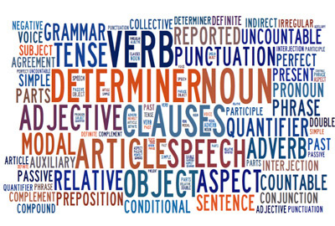
Word Classes
Let’s brush up on the basics

Slide 2
How many terms related to English Language studies can you name?
dialect
verb
singular
semi-colon
noun
indirect speech
adverb
hyphen
lexis
synonym
adjective
speech marks
consonant
Standard English
accent
clause
punctuation
vowel
pronoun
modal verb
colon
plural
direct speech
question mark
antonym
preposition
dipthong
full stop
comma
homophone
syllable
conjunction
passive
homonym
active
apostrophe
exclamation mark
definite article
syntax

Slide 3
In your own words, tell me what the following terms mean…
Noun
A person, place or thing
I have a dog with a black nose whose tail wags quickly.
I have a dog with a black nose whose tail wags quickly.
Verb
An action
I have a dog with a black nose whose tail wags quickly.
I have a dog with a black nose whose tail wags quickly.

Slide 4
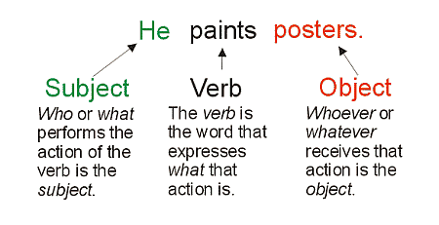
Subject-Verb Agreement
Most sentences we write typically follow a subject-verb-object pattern.
The subject is the ‘do-er’ of the sentence, ie the person or thing that is performing an action.
The verb is this action, ie the thing that is being done.
The object is the recipient of the action; it is who or what the verb is being done to.
This may seem complicated, but we are already familiar with this pattern. Look at this example:
To determine the subject, verb and object, we need to ask some questions.
The first question we should ask is:
What is being done?
In this case, one person is loving another person, so ‘love’ is being done. The verb is ‘to love’.
Who or what is doing the verb (or action)?
Who is the person that is doing the loving? We’re told that Peter loves Becky, so Peter is the person performing the action. This means Peter is the subject. The sentence is about him and what he does.
Who is receiving the action?
Who is being loved? Becky is the person being loved, so Becky is the object.
Peter loves Becky.

Slide 5
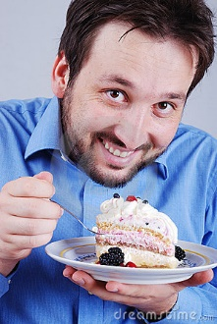
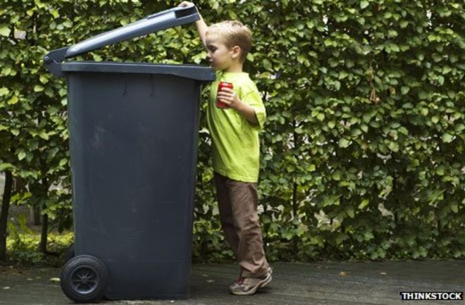
So, subject–verb–object (SVO) is a sentence structure where the subject comes first, the verb second, and the object third. English is an SVO language.
Let’s Practise
The man is eating a cream cake.
Bob is eating cake.
What is:
A subject
A verb
An object?
Bob ate cream cakes.
He ate a cake.
He ate the cake.
John collected litter.
He eats cakes.
The boy picked up the litter.
Bob ate.

Slide 6
Subjects, Verbs, Objects
BEGIN

Slide 7
bother!
Try again

Slide 8
Click on the subject
I
hate
cabbage!

Slide 9
Well done!!
1 point

Slide 10
Click on the object
I
have read
a good book

Slide 11
Great!!
2 points

Slide 12
Click on the subject
Peter
loves
Mary

Slide 13
Good!!
3 points

Slide 14
Click on the verb
Cats
chase
mice

Slide 15
Wicked!!
4 points

Slide 16
Click on the object
You
have got
a letter.

Slide 17
Cool!!
5 points

Slide 18
Click on the verb
I
shall see
my uncle

Slide 19
Well done!!
6 points

Slide 20
Click on the subject
The film
bored
us.

Slide 21
Well played!!
7 points

Slide 22
Click on the subject
They both
play
chess.

Slide 23
Bravo!!
8 points

Slide 24
Click on the verb
Mice
adore
cheese.

Slide 25
Excellent!!
9 points

Slide 26
Click on the subject
Who
has eaten
the chips?

Slide 27
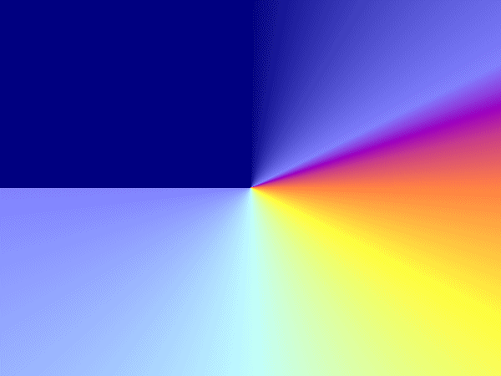

10 points!!
Play again

Slide 28
exit
Chris Reall 2004

Slide 29
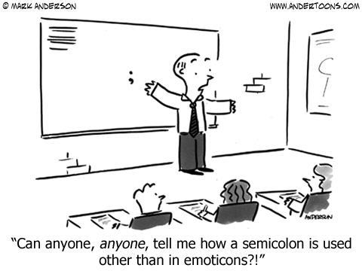
Semicolons
What the heck are they, and when should I use one?!

Slide 30
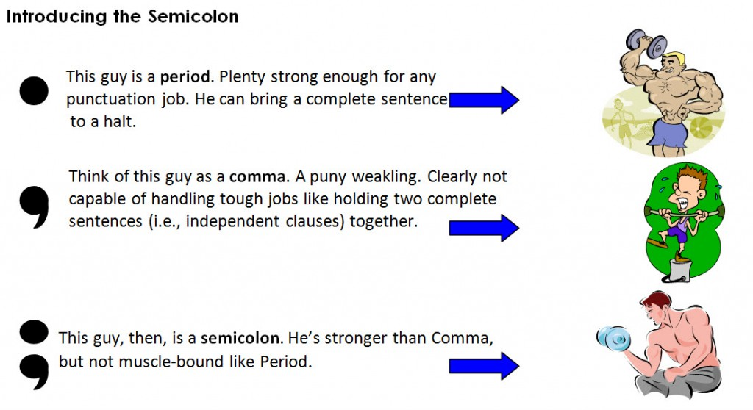
full stop.
full stop.

Slide 31
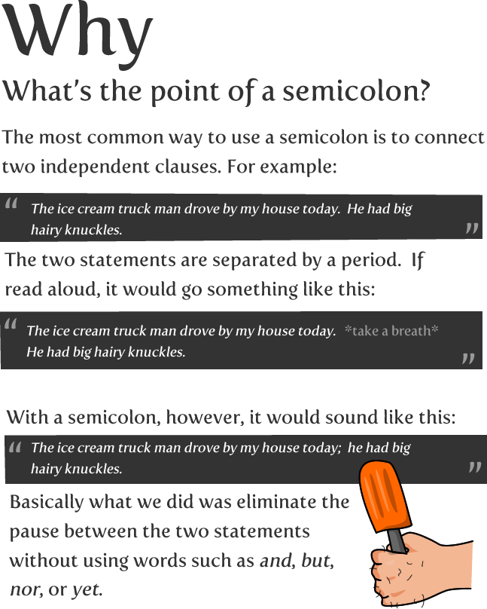
a full stop.

Slide 32
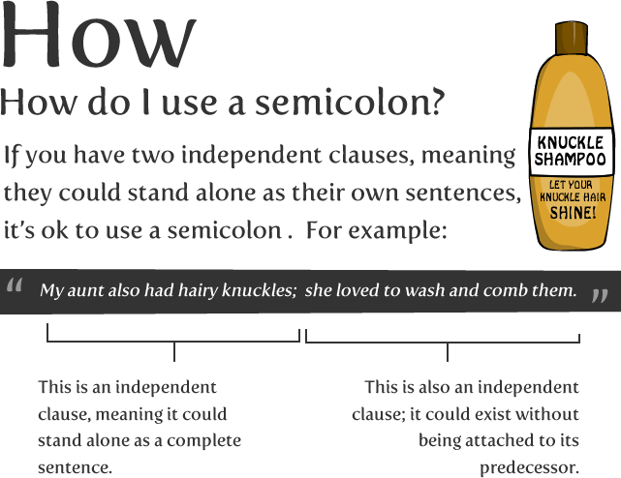

Slide 33
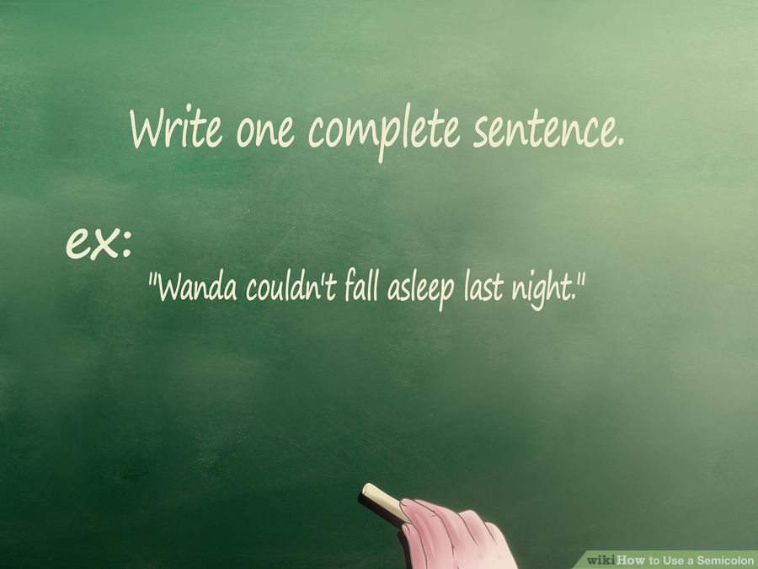
1. Write one complete sentence. A complete sentence must contain a subject and a verb and be a complete thought. The subject is the person, place, or thing that the sentence is about, and the verb is the action that is being performed in the sentence. Ex: "Wanda couldn't fall asleep last night."

Slide 34
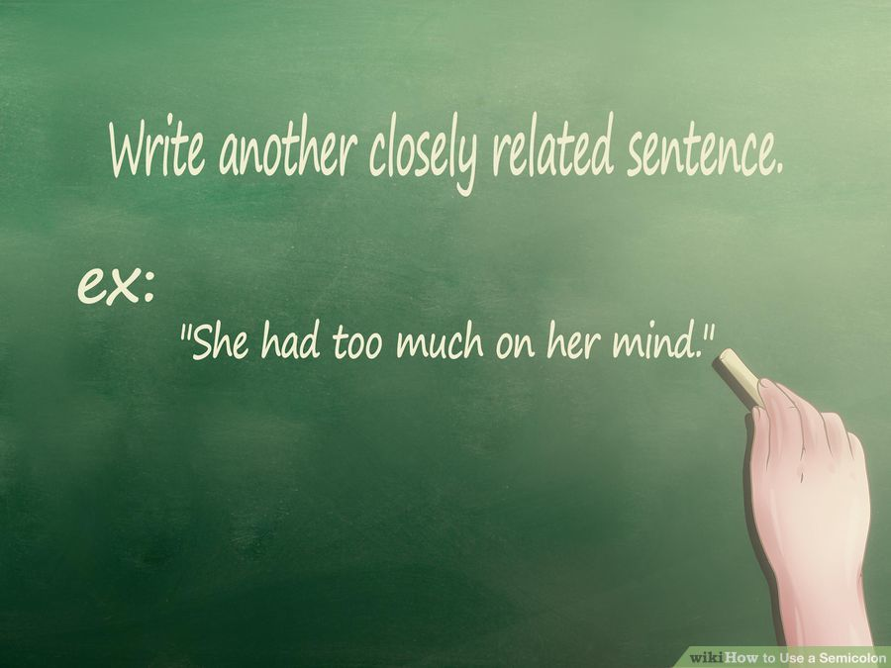
2. Write another closely related sentence. This sentence must be strongly related to the first sentence for the semicolon to work. Ex: "She had too much on her mind."

Slide 35
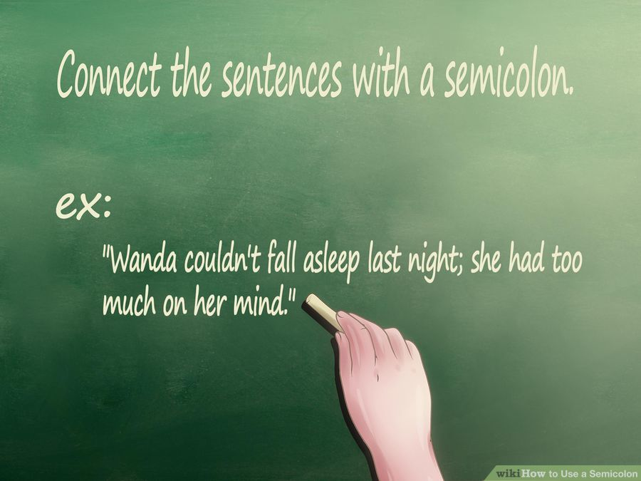
3. Connect the sentences with a semicolon. Remember to make the first letter of the second sentence lowercase. Ex: "Wanda couldn't fall asleep last night; she had too much on her mind."

Slide 36
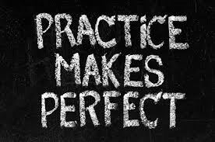
For some extra practice, have a go at the exercises found at the links below. Have fun!
http://depts.dyc.edu/learningcenter/owl/exercises/semicolons_ex1.htm
http://www.bristol.ac.uk/arts/exercises/grammar/grammar_tutorial/page_48.htm

