Slide 1


Slide 2

How we structure our reading
Once children have completed their phonics reading using Little Wandle, they move onto Bug Club books.
These books are structured by year group which means your child will start each year on that classes books. Teachers carry out an assessment at the beginning of each new year, which will determine which books to start on.
If your child is ready, they will move onto be a free reader in that particular year. When they move up to the next year, the process starts again.

Slide 3
Fluency
Before children can understamd what they are reading, they must have good fluency. At the end of year 2, it expected that children should be able to read 90 words per minute of an age appropriate text.

Slide 4
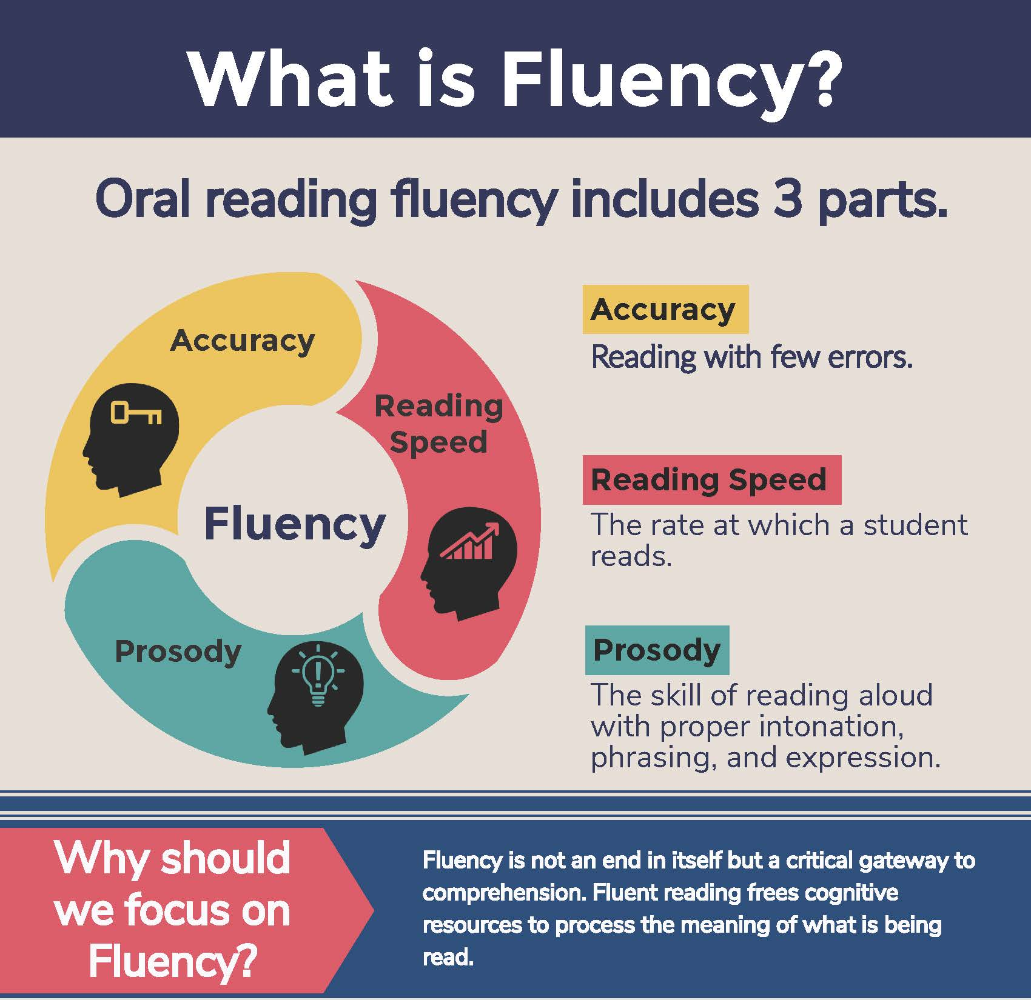

Slide 5
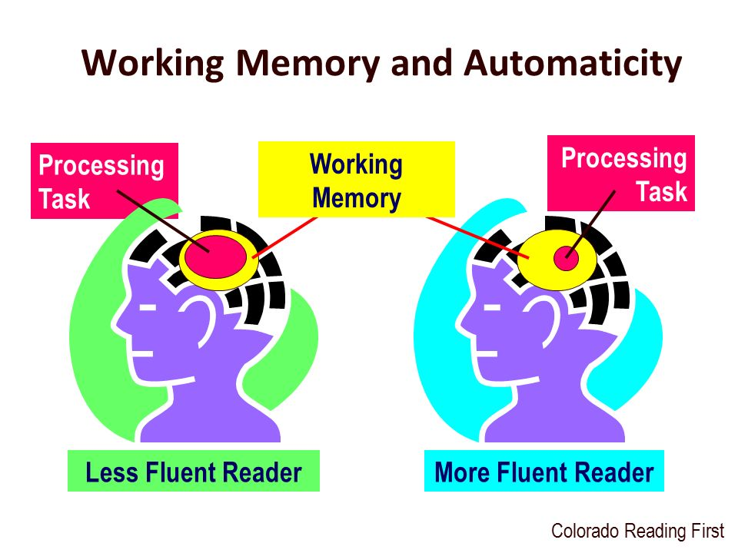
Less fluent readers must focus their attention and energy on decoding text, recognising individual words, and then trying to string them together for meaning, leaving them little attention for understanding the meaning of text. Their reading is less ‘smooth’ because they need to decode words. By the time the child gets to the end of a sentence, they may not even remember what has been read. This means that if a reader is using their ‘cognitive resource’ to decode words on the paper, there is little processing space to make sense of the text/comprehend the text.

Slide 6
How we structure our reading
Throughout the reading process, the children are assessed using the following:-
VIPERS
Vocabulary
Inference
Prediction
Explaining
Retrieval
Summerising

Slide 7
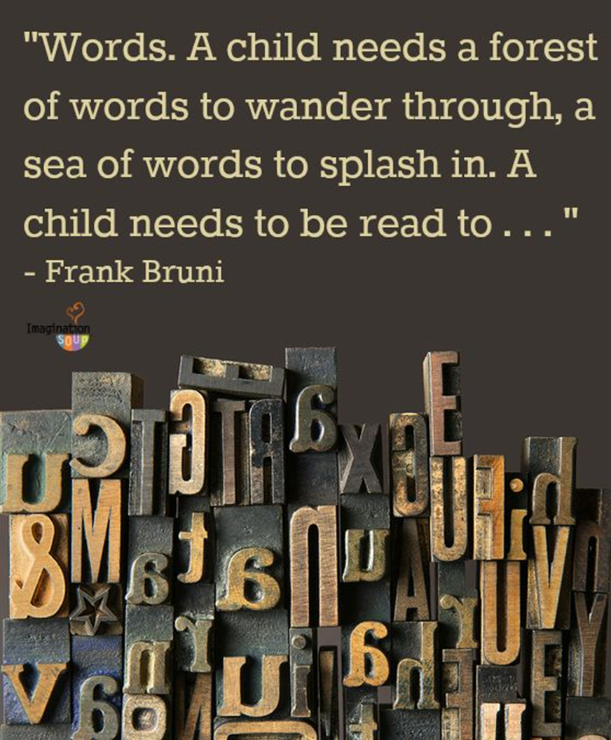
Vocabulary

Slide 8
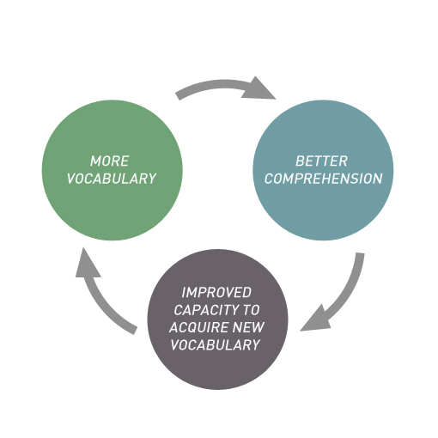
Good vocabulary instruction
helps children gain ownership of words (being able to use or think about a word in a variety of different ways).
provides multiple exposures though rich a varied activities to meaningful information about the word.
includes both definition and contextual information about each word’s meaning.
involves children more actively in word learning.

Slide 9
Vocabulary
Building vocabulary from EYFS to KS2 is key to understanding of what children understand. It also has an impact on their writing skills.
The number of words you know and can use confidently and appropriately has a direct impact on your success as a reader, as well as your ability to express and communicate your ideas to others.
GCSE performance can be predicted from the size of children’s working vocabulary as they start school.

Slide 10
Vocabulary
The difference in the number of words heard by children from a ‘language rich’ home in comparison with children from ‘language impoverished’ homes, by the age of 4.
32,000,000

Slide 11
Vocabulary
Starting school
The average working vocabulary of
a reasonably well performing child.
The average working vocabulary of a poorly performing child starting school
7,100
3,000

Slide 12

How many words children will have heard by the time they are five years old
• Never read to: 4662 words
• 1 – 2 times a week: 63,570 words
• 3 – 5 times a week: 169,520 words
• Daily: 296,660 words
• 5 books a day: 1,483,330 words
Science Daily (2019), quoted in the Reading Framework

Slide 13
Vocabulary
Children who have a good understanding of vocabulary will find inference and retrieval much easier.

Slide 14
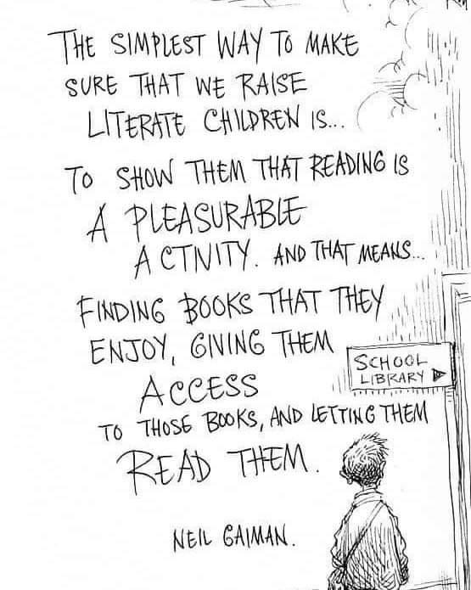
Reading for pleasure

Slide 15
This year we are promoting reading for pleasure alongside our reading scheme.

Slide 16
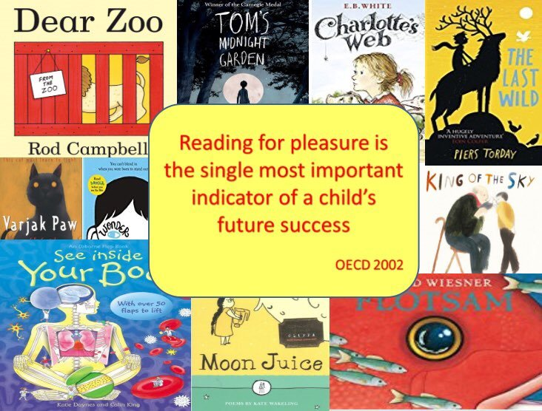

Slide 17
READING FOR PLEASURE
In school, the teachers are reading to the children. They just read. There are no questions, just the enjoyment of reading/listening to a variety of texts from picture books, poetry, short stories, non-fiction, graphic novels
Children spend time reading whatever they want to read on that day, silently or sharing books with classmates.
Book recommendations from other children and teachers are shared
Even if a child says, “I don’t like reading,” we believe that they haven’t found the right type of book.
We want children to realise that reading isn’t just about their school reading book, but is much more

Slide 18
How can Parents help?

Slide 19
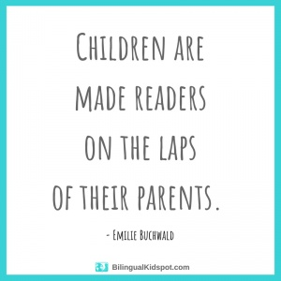
Parents can help by taking a proactive role in encouraging reading for pleasure
Read at home with/to the children
Family Story Sessions
Vocabulary Day
Let children choose the book. Picture books bring children’s imagination to life. No book is too easy.

Slide 20
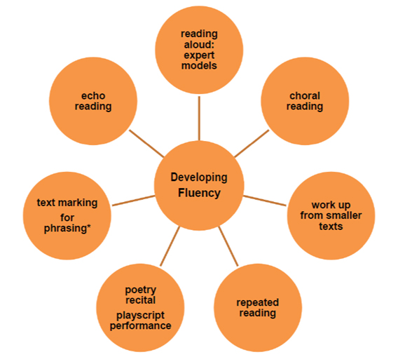
How can parents help with fluency?

Slide 21
How to help with Vocabulary
When reading with your child, ask them what words mean. You will be surprised at the words we find easy, they will find tricky.
Always start with really easy words to build their confidence

Slide 22
Introduce the new word and highlight its features:
• Pronunciation
• Meaning
• Example
• Explanation
• Interesting features
• Identify word part (morphemes)
Discuss some or all of these elements
• Context it would be used in
• Synonyms, relatives and relationships
• Antonyms
• Word functions - grammar
• Etymology
• Dictionary

Slide 23
Text discussion/ comprehension
: Summary of text main ideas.
Who? When? Where? How? Why?
Ask a couple of questions to focus on helping children understand what the question is asking.
Consider how to make questions more challenging e.g. asking questions that require evidence from across the text.
Tell me: Opportunity for children to talk about any aspect of the text or specific aspect. E.g. Tell me more about… find in the text…
Discuss use of vocabulary
The Big Question: Following a thread e.g. as I read through, tell me when you hear words/phrases that show humour/ give you an idea of this character’s intentions/ show you that the author thinks highly of x or feels sorry for x / what impression do you get of….? etc.
What does it mean? What thoughts has this text prompted? What are the themes and are they linked with any other texts you know? E.g. resilience, the strength of family bonds, side-lining those who are different, bravery etc.

Slide 24
Thank you for listening.
Any question?

