Slide 1

MAKING SENSE OF SENSORY BEHAVIOURS
A Workshop for Parents and Carers

Slide 2



WHAT IS
SENSORY PROCESSING?

Slide 3
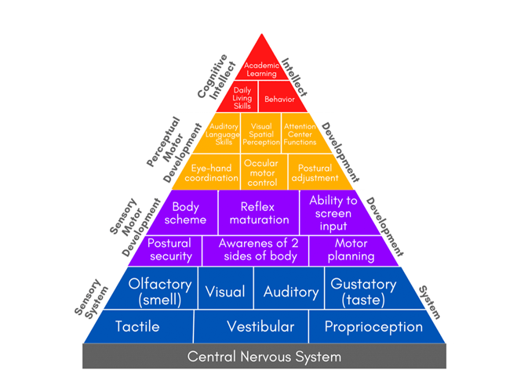
The Learning Pyramid – Williams and Shellengerger

Slide 4
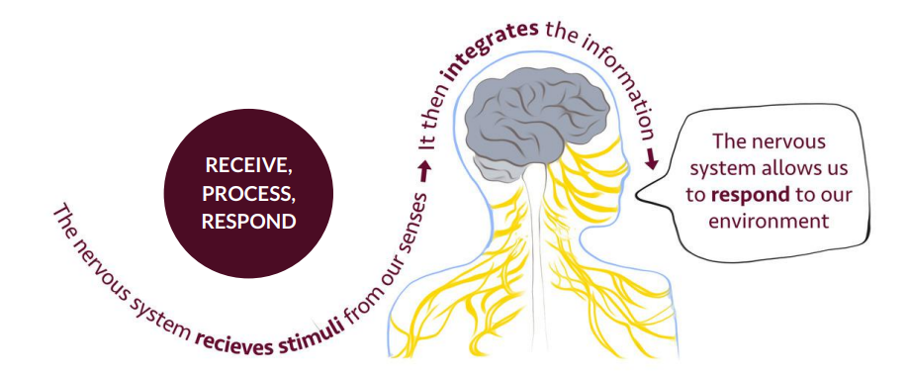

Slide 5

SENSORY REGULATION

Slide 6
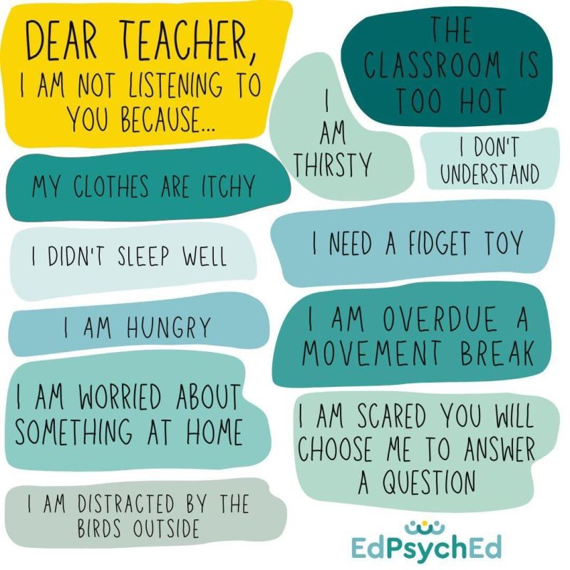

Slide 7

THE SENSES
TOUCH/TACTILE
VISION
HEARING/AUDITORY
TASTE
SMELL/OLFACTORY
MOVEMENT/VESTIBULAR
BODY/PROPRIOCEPTION
INTEROCEPTION

Slide 8

THE TACTILE SYSTEM

Slide 9
What behaviours might we see when there is a problem?
Over responsive
Avoids playing or sitting near others
Fussy about clothes fabrics, seams and labels
Dislikes messy play
Dislikes being dirty, quickly wipes hands
Can react aggressively to another’s touch
Dislikes teeth and hair brushing, nail cutting and other self-care tasks
Very sensitive to pain and temperature
Fussy eater – sensitive to textures
Under responsive
Only registers firm touch
Loves messy play
May not realise when they are messy/dirty
Heavy handed, tight grip (e.g. pencil)
Overly tactile with objects and people
Licking and mouthing of objects
Likes extreme temperatures e.g. ice cubes, very hot baths
Has difficulty responding to temperature, high pain threshold

Slide 10

visual, auditory, olfactory& gustatory systems

Slide 11
What behaviours might we see when there is a problem?
Over responsive
Dislikes bright lighting, prefers dark environment
Covers eyes outside
Is distracted by visual information
Noise levels feel magnified
Dislikes loud noise
Extreme reactions to loud or unexpected noises
Easily startled
Notices noises others may not hear
Distracted in noisier surroundings
Anxious before expected noise (e.g. school bell)
Talks loudly
Hums or makes noises to themselves
Dislikes strong tastes/smells
Prefers bland tastes/smells
Anxious of new foods
Smells people
Over-reacts to new smells
Gags easily

Slide 12
Under responsive
Needs more visual information to react
Likes bright environment, reflective or spinning lights, light-up toys
Stands very close to the TV
Waves objects close in front of face
Enjoys really loud noise
Does not hear name being called
Needs instructions repeated several times
Makes noise to themselves
Eats non-food items (Pica)
Craves strong tastes – spicy or highly seasoned food
Licks and smells objects, people
Under-reacts to strong, bad or good smells

Slide 13
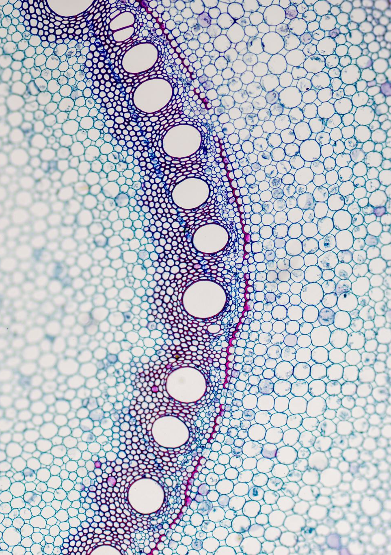
Vestibular system

Slide 14
What behaviours might we see when there is a problem?
Over responsive
Hates spinning, jumping
Becomes dizzy easily
Hates a busy place full of movement
Avoids feet being off ground (e.g. avoids swings)
Dislikes head being tipped back (e.g. for hair washing or if tilted in space in specialist seating)
Travel sick
Clumsy and uncoordinated
Poor posture
Under responsive
Always on the go
Difficulty sitting still
Constantly fidgeting
Runs rather than walks
Takes risks – no danger awareness
Fast but not always well co-ordinated

Slide 15

Proprioceptive system

Slide 16

What behaviours might we see when there is a problem?
Under responsive
Bumps into or trips over things/people
Poor motor planning in PE, difficulty copying movements in dance
Poor aim and force in ball skills
Stands too close to others
Crams mouth when eating
Uses excessive force – overly rough in play
Avoids open spaces – sticks to the outskirts of the playground/room
Scared of dark – sleeping problems
Looks at feet when going down the stairs
Squeezes self in too small spaces or pushes against corners of the room
Seeks climbing and hanging
Difficulty sitting still, fidgets, rolls around on the floor

Slide 17

INTEROCEPTIVE system

Slide 18
What behaviours might we see when there is a problem?
Over responsive
Negative responses to internal bodily functions e.g. tummy rumbling, a full bladder, increased heart beat and temperature when exercising etc.
Due to a fear of feeling these bodily sensations, the child may avoid them by:
  Overeating to avoid feeling hunger pangs
  Needing to always have a drink near them
  Going to the toilet more often than necessary and needing to know where the toilet is at all times
May be distracted by own heartbeat
Under responsive
Toileting accidents
Need reminding to eat and drink
May have more frequent bouts of constipation or get easily dehydrated from not eating or drinking enough
May dress inappropriately for the weather
Difficulty identifying feelings, coping with big feelings
Confuse one feeling for another e.g. they may say they have a tummy ache when it is actually hunger or needing the toilet
May seek out fast movement as they like the feel of breathing fast and an increased heart rate and body temperature
May overeat or drink to gain the feeling of being full

Slide 19

SO WHAT WE CAN WE DO TO HELP?

Slide 20
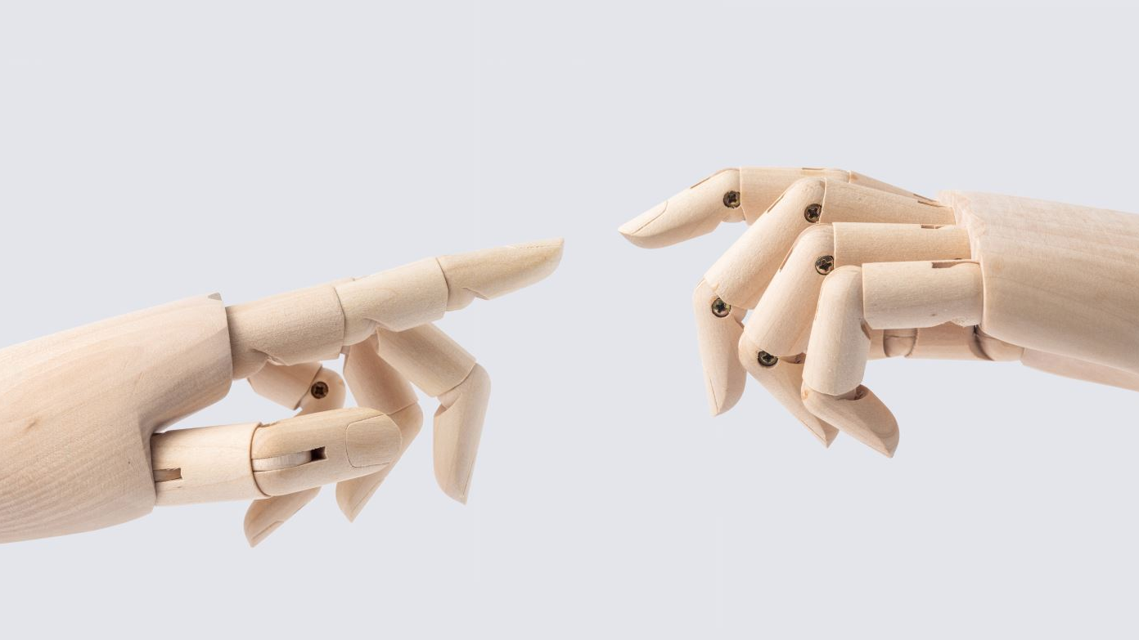
HEAVY WORK – PUSH, PULL, LIFT
Hanging and climbing!
Chair pulls and pushes
Hands on head and pressing down
Push palms together
PUSH HERE station
Hugging knees to chest
Giving yourself a hug
Moving furniture, carrying books
Weighted bag/backpack
Squeezing a small fidget toy
Squeezing and relaxing jaw and/or hands
Squeezing into a small space/den
Sucking a sweet or mint
Drinking through a straw, sports bottle
Blowing, bubbles, ping pong football
Chewing chewy tube/chewigem
Chewy snacks – dried mango, bagel
Therapy band

Slide 21

CALMING TIPS
Environmental adaptations
Deep pressure massage
Slow rocking e.g. Rocking chair, hammock swing
Allow chill out time in a den or quiet space at regular times (mid-morning, mid-afternoon, after school)
Have a corner with favourite sensory activities to go to when needed
Soft classical music
Lavender scents

Slide 22
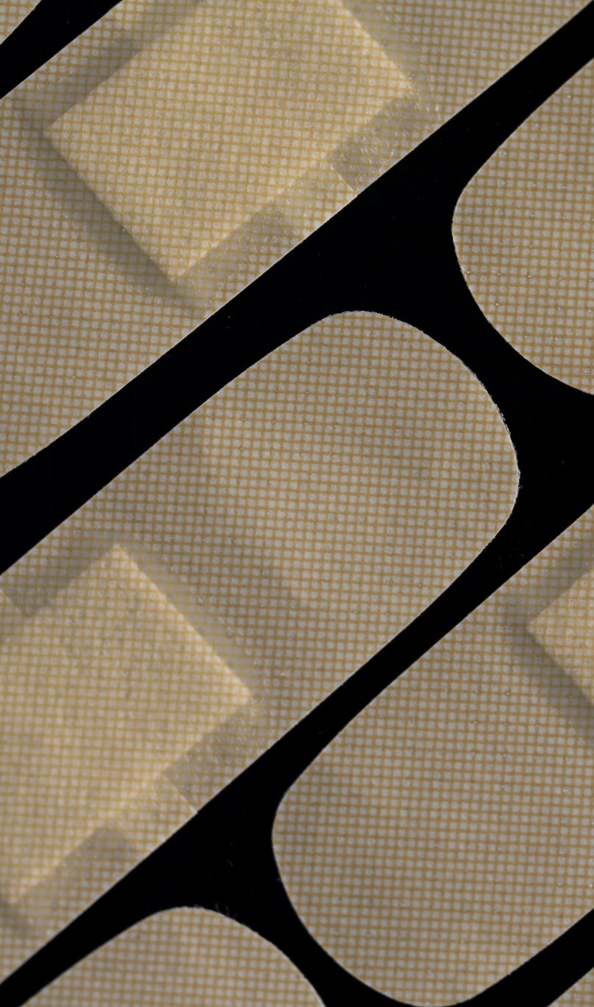
TOUCH
Over responsive
Deep pressure not light touch
Hand massage before messy play
Start with dry textures and gradually introduce wet, use dry materials that have liquid quality
Head/face massage before hair brushing
Blowing and sucking games
Chewy foods
Seamless pants and socks
Vibration
Under responsive
Deep pressure and massage
Lots of messy play
Tactile toys – spiky balls, nobbly balls, brushes, massage tools, vibrating toys
Fidget toys
Chewy tube/chewigem
Blowing and sucking games
Crunchy and chewy foods
Very cold foods e.g. Ice lollies, ice cubes

Slide 23

VISION
Over responsive
Sit away from windows, doors, noticeboards
Limit wall art
Desk divider or individual workspace
Dim lighting
Sunglasses outdoors
Under responsive
Light up sensory toys
Interactive whiteboard
Visual workspace

Slide 24

HEARING/AUDITORY
Over responsive
Ear defenders in noisier surroundings (e.g. Lunch hall, public places)
Sit away from windows, doors and close to teacher
Access to a quiet space for chill out
Soft classical music
Separate lunch area
Warning before fire alarms
Under responsive
Noisy sensory toys
Upbeat music
Sit close to the teacher
Make sure you have the child’s full attention before giving instruction

Slide 25
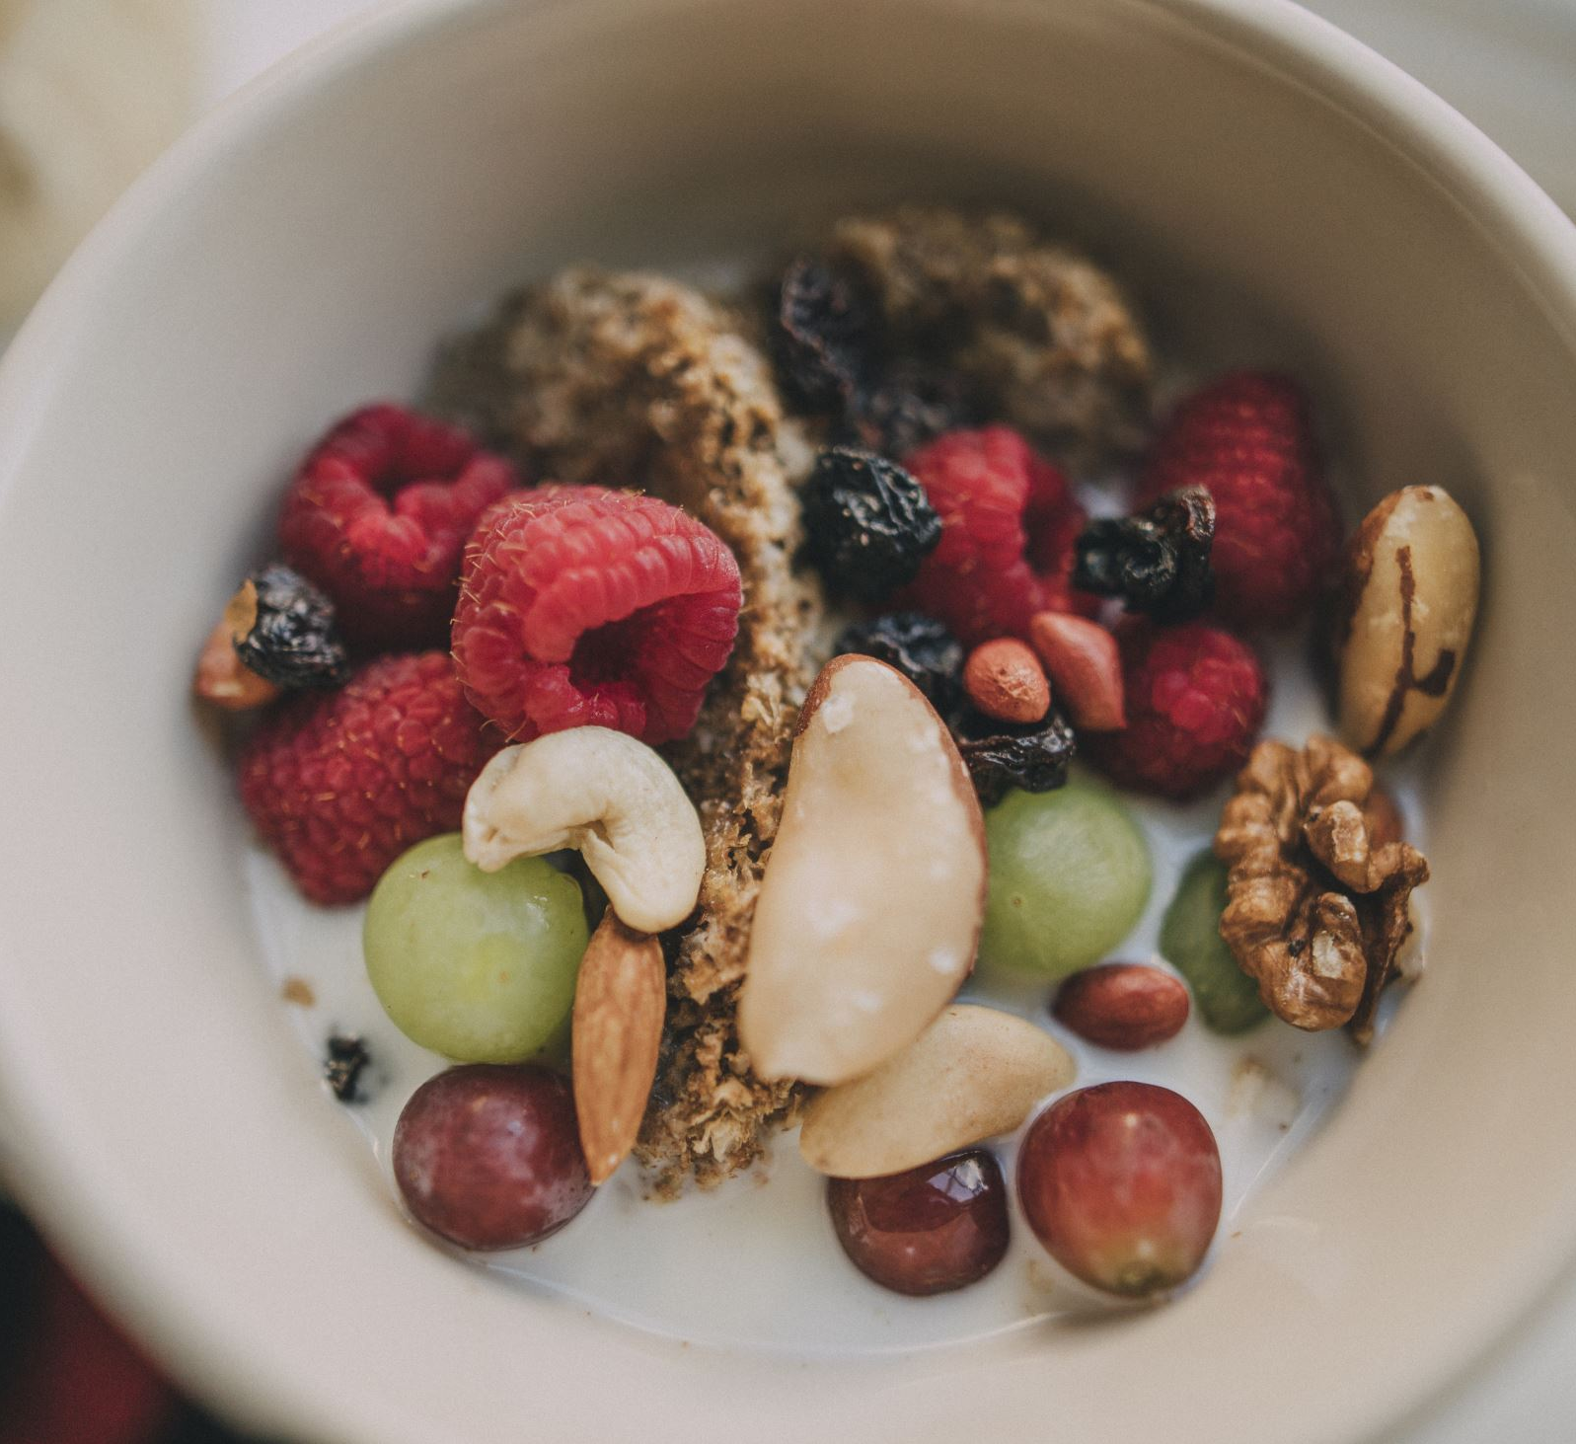
TASTE & SMELL
Over responsive
Food play
Sucking and blowing games
Drink thick liquids through a straw
Chewy foods
Preferred smell on hankie
Under responsive
Highly spiced and flavoured foods
Very cold foods e.g. Ice cubes and lollies
Crunchy and chewy foods
Scented play dough, moisturisers etc.

Slide 26
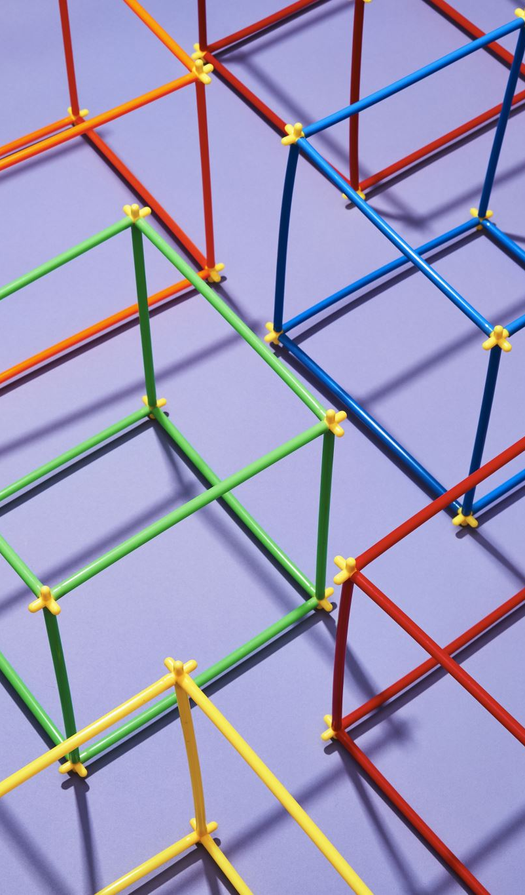
MOVEMENT
Over responsive
Slow, linear movement e.g. Rocking in a hammock, rocking chair
Avoid spinning activity in favour of resistive activity – push, pull, lift
Swimming
Lie on tummy for fine motor activities, watching TV
Under responsive
Lots of climbing and hanging activities – hang upside down
Jumping
Regular movement breaks
Fidget toys

Slide 27
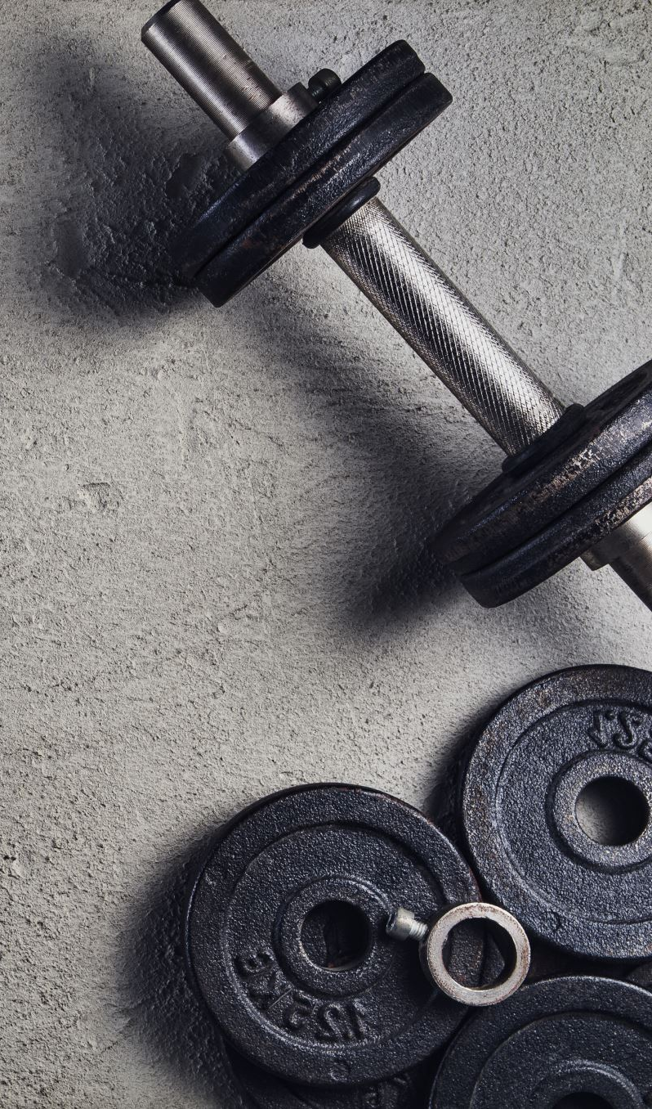
PROPRIOCEPTION
Under responsive
Climbing, hanging
Beanbag chair
Sit with back supported when on the floor
Fidget toys, chewy tube/chewigem
Chewy snacks, drink through straw
Regular movement breaks, incorporating heavy work
Small den – confined space to squeeze into (lycra tunnel)
Tuck in tightly/wrap up tightly

Slide 28
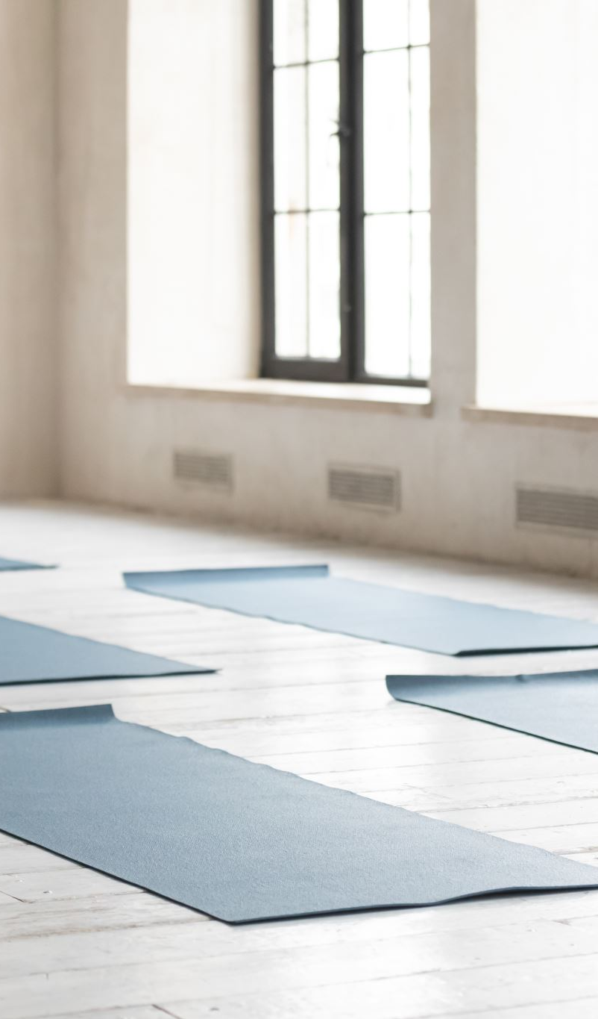
INTEROCEPTION
Get curious about how different sensations, activities and situations make your body feel. Concentrate on different body parts and guide your child to think about how these parts feel at different times e.g. outdoors vs indoors, during physical activity, when eating or drinking a cold drink
Try simple breathing techniques
Yoga – hold simple yoga poses, concentrating on which parts of your body are stretched, which are relaxed and which are touching the floor
Guided meditations – body scan
Adult modelling and normalising feelings
Individual emotional supports e.g. Feelings scale

Slide 30
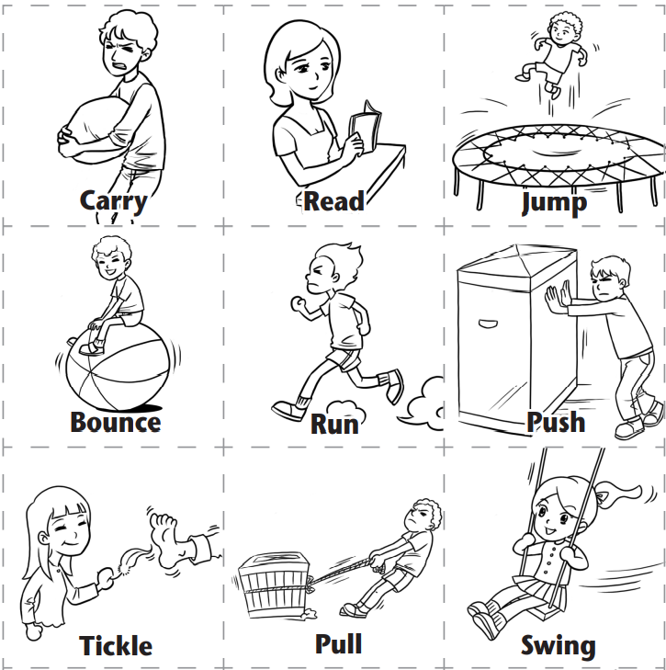
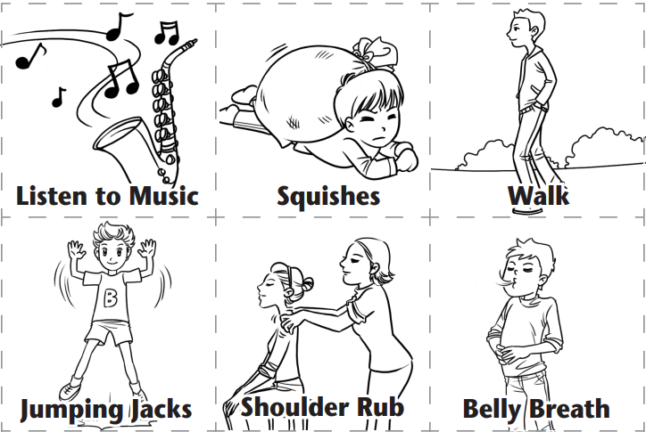
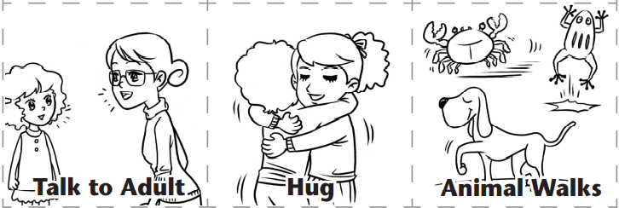

Slide 31

Useful information
Making sense of sensory processing by rosie holliday – available at amazon (kindle also available)
The out of sync child by carol kranowitz
The interoception curriculum by kelly mahler
Www.Therapyspot.Uk – rosie@therapyspot.Co.Uk

