Slide 1
Ufton Court 2026

Slide 2
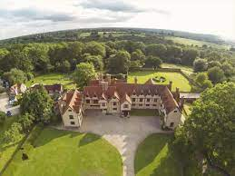
Ufton Court, Ufton Nervet, Reading
A small medieval manor, steeped in history.

Slide 3
Ufton Court 2026
Support our study of The Tudors and engage their learning – The Raid, Tudor Banquet, Tudor dancing (with costumes!)
A chance to show their independence
Teamwork – looking out for one another
Chance for children to shine that may find the curriculum difficult.

Slide 4
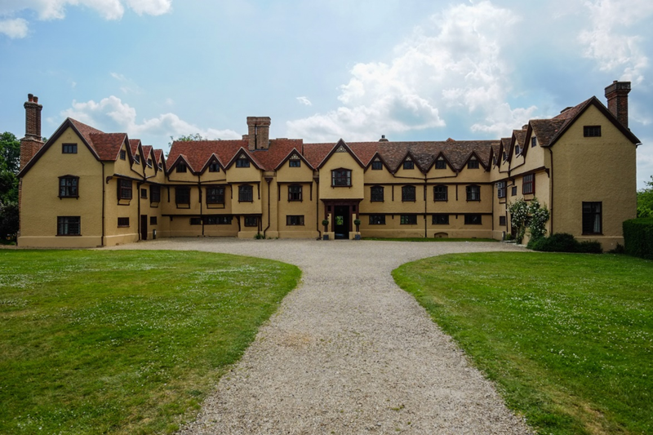

Slide 5
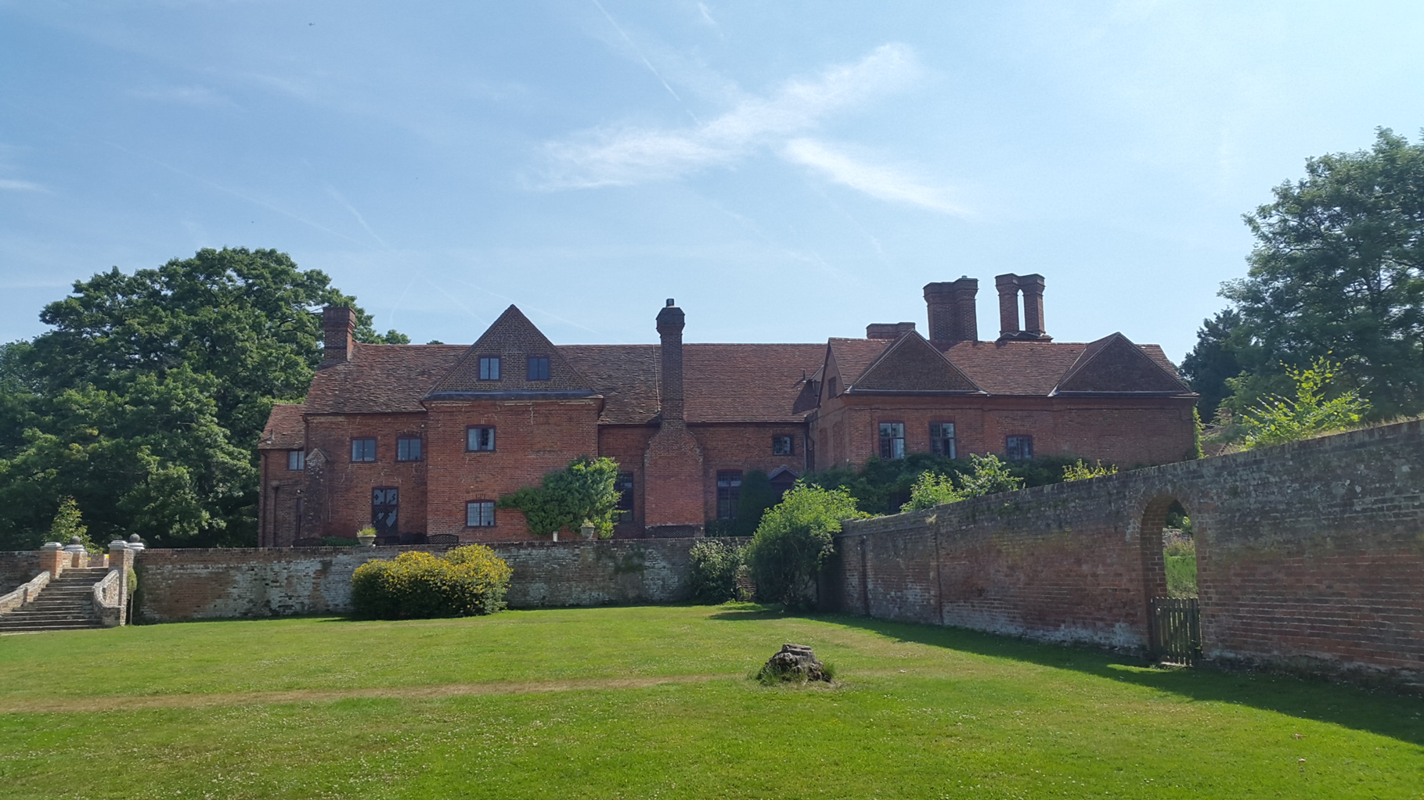

Slide 6
Ufton Court 2026
When : 7th – 9th January 2026
Who : Lead teacher Mr Salter supported by Mrs Hamilton and Mrs Reekie (evenings)
Cost : £223 per child
Includes : Transport, overnight accommodation (2 nights), all food, all activities.
Insurance : Covered by Borough insurance

Slide 7
Ufton Court 2026
Leave school 9am on the Wednesday and return by 3.15pm on the Friday
https://www.uftoncourt.org.uk/
Stay in the cabins
Own dining cabin
Play area outside

Slide 8
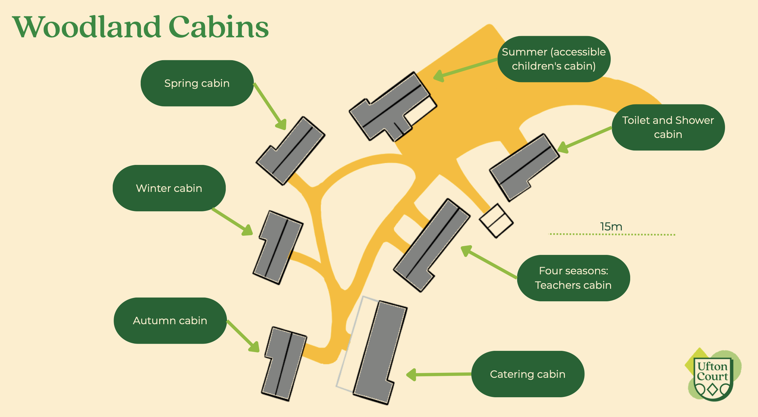

Slide 9
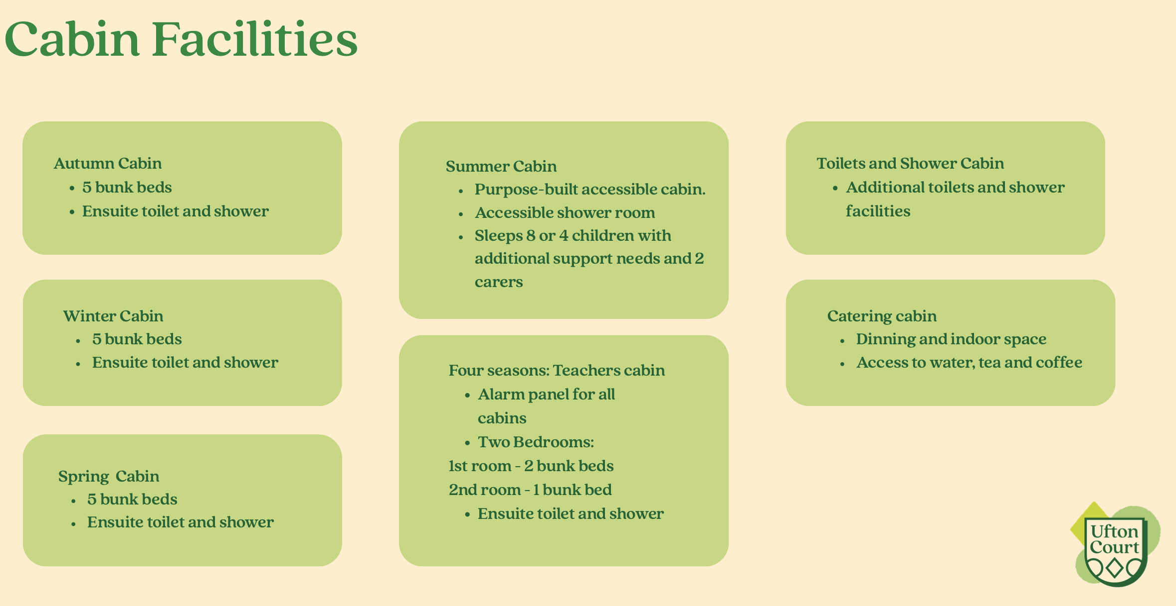

Slide 10
Ufton Court 2026
Food – lunch, dinner, breakfast, lunch, banquet, breakfast and packed lunch
All allergies are catered for
All help tidy

Slide 11
(Sample menu. Will confirm with Ufton Court and let you know closer to the time)
Day 1
Morning snack: Fruit on arrival (apples, pears, oranges & bananas).
Lunch: Jacket Potato, Beans, Cheese, Tuna & Mayonnaise, Salad. Yoghurts. (GF, V, Ve).
Afternoon Snack: Biscuits (GF, V, Ve).
Dinner: Tomato & Basil pasta bake with garlic bread and roasted vegetables (GF, V, Ve). Pudding Apple crumble & custard (GF,V, Ve).
Day 2
Breakfast: Self-service with a choice of cereals (Multigrain Hoops (V, Ve), Weetabix (V, Ve) or corn flakes (GF, V, Ve)) Toast (GF) with butter (GF, V) and/or jam (GF, V, Ve). Fresh fruit.
Morning snack: Carrot & cucumber sticks.
Lunch: Hot dog/Veggie Hot Dog (GF, V, Ve) and salad. Jelly. (GF, V, Ve).
Afternoon Snack: Flapjack. (GF, V, VG).
Dinner History: Banquet roast chicken (GF)/Cheese and Broccoli Quon(V), Roast potatoes (GF, V, Ve), Corn on the cob and Bread rolls (V, Ve). Pudding Banquet cake (GF, V), with fresh fruit.
Day 3
Breakfast: Self-service with a choice of cereals (Multigrain Hoops (V, VG), Weetabix (V, Ve) or corn flakes (GF, V, Ve)) Toast (GF) with butter (GF, V) and/or jam (GF, V, Ve). Fresh fruit.
Morning snack: Fresh fruit (apples, pears, oranges & bananas). (GF, V, Ve).
Lunch: Sausage Rolls (GF, V, Ve), crisps (GF, V, Ve) Cookies (V) & fresh fruit (apples, pears, oranges & bananas).

Slide 12
Ufton Court 2026
Activities
Exploring the grounds
Exploring the manor house
Photomapping
Tudor crime and punishment
Bow making
Banquet
The Raid
Tudor dancing and games
Fire lighting

Slide 13
Ufton Court 2026
On class page on the website:
Kit list
Medical and dietary forms to be returned by Friday 21st November 2025

Slide 14
Ufton Court 2025
Any questions?

