Slide 1

Reading at Cookham Dean

Slide 2

How we approach Reading at Cookham Dean
In reception and Key Stage one (Years 1 and 2), children will learn their phonics and will have their reading book matched to the phonics sounds they are doing.
We use Little Wandle which is a highly structured system to teach phonics/reading which shows progress throughout each class.
During this time, they will be working on their fluency and expression and will be asked questions about the book they are reading in order for us to understand how much of the story they are understanding.
In the summer term the year 1 children will take a phonics test set by the Government. If they do not pass this in year 1, they will retake it again in year 2.

Slide 3
How we approach reading at Cookham Dean
In Key stage 2 (Year 3, 4, 5 and 6), we use a reading scheme called Bug Club. Each year group has their own set of books, which coincide with the objectives that need to be taught throughout the year.
In September, the children will carry out an assessment, which informs the class teacher which book they will start on. There are many reasons why a child would have been given a book. They could be working on their fluency and reading trickier words, they may need to work on inference or retrieval. Once the children have read Bug Club books and the teacher is confident that they can answer the questions (usually, it is inference that is tricky), they then become a free reader in that year group only. Each year the children will be re-assessed at the start of the new year.

Slide 4
Guided reading sessions
We use a systematic approach, called VIPERS to teach reading. This may be done in small groups or completed as a whole class.
Below is an example of how guided reading could be taught on a daily basis. This style of guided reading starts in KS1 through to the end of KS2. During the guided reading sessions, the teacher may use the reading book the whole class is using/Bug Club guided reading books or reading material from Literacy Shed.
Monday | Tuesday | Wednesday | Thursday | Friday
Fiction | Non-Fiction | Non-Fiction | Fiction | Reading for pleasure
Vocabulary & Inference | Prediction | Explain & Retrieval | Summarise | Library time

Slide 5
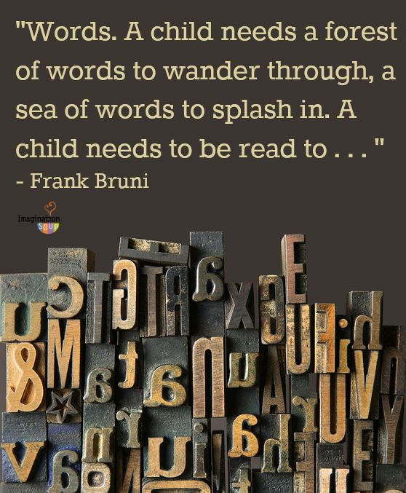
Vocabulary and why it is important

Slide 6
Vocabulary and why it is important
The number of words you know and can use confidently and appropriately has a direct impact on your success as a reader, as well as your ability to express and communicate your ideas to others.
GCSE performance can be predicted from the size of children’s working vocabulary as they start school.

Slide 7
Vocabulary and why it is important
How many words children will have heard by the time they are five years old?
Never read to: 4662 words
• 1 – 2 times a week: 63,570 words
• 3 – 5 times a week: 169,520 words
• Daily: 296,660 words
• 5 books a day: 1,483,330 words

Slide 8
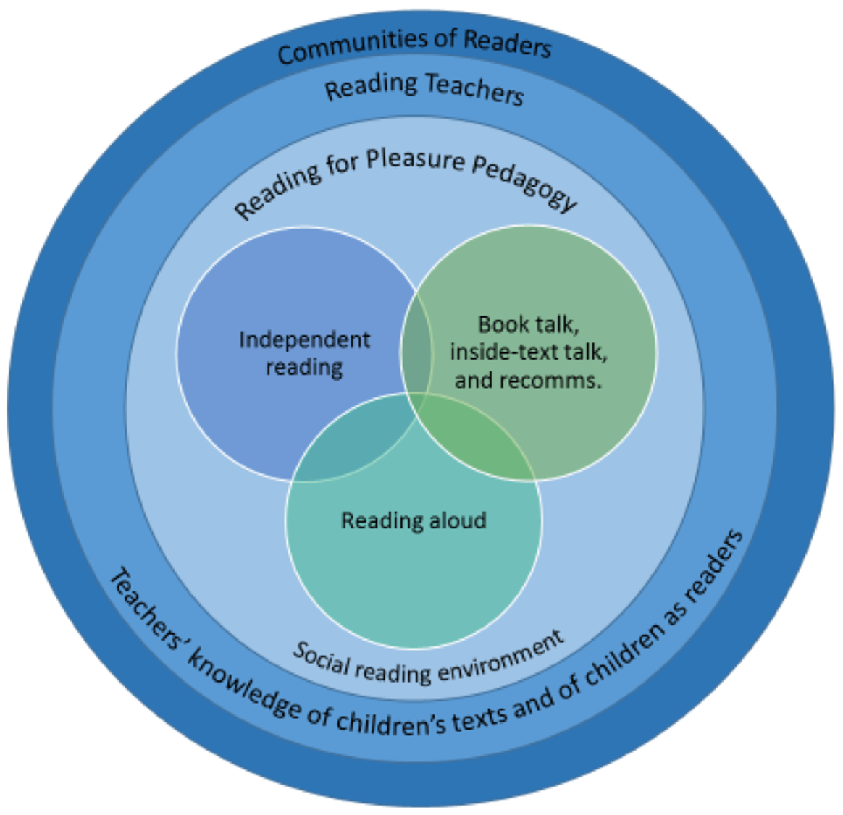
Reading for Pleasure

Slide 9
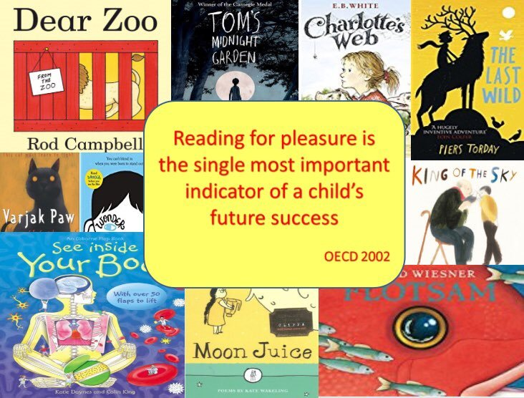
Reading for Pleasure
At Cookham Dean we promote the love of reading through our reading for pleasure times. This could be independently reading, book discussions with their friends, library time, being read to. Which ever way we do it, the children can read whatever they want to, from chapter books, picture books, factual books, comics, graphic novels. The idea of these sessions is that children begin to realise that reading is the best thing ever.

Slide 10
Reading for Pleasure – How can parents help
Take them to the library
Have family reading days with a theme
Read different Genres of writing
Read the cereal packets
Have a word of the day
Put the subtitles on the television
Most of all, make it fun!

Slide 11
Parent/Carer helpers in school
You may hear them read from their reading books, so will need to ask questions from the section they read from or you will be given an extract for them to read with set questions for you to ask the children. Parents will then sign to say they have read with an adult.
How you can help your child at home
Listen to them read at home, ideally on a daily basis
If they want to read on their own, ask your child questions about their book
Make reading part of your daily routine.
Read with or to your child books above their age
Look up meaning of any new words they come across
Be good role models
Look at class pages for recommended books
Use the library for recommended books

Slide 12
Any questions?

