Slide 1

Welcome to
Cookham Dean Primary School
Parents meeting 2025
www.cookhamdean.org

Slide 2
Introductions
Mrs Reekie - Headteacher
Ms Fernandez– Class Teacher
Sandy and Karen– WrapAroundCare4U
Parent – School Uniform
PTA

Slide 3
Where We All Flourish
Christian Values – friendship, community, endurance, peace, joy, trust, forgiveness.
6Rs – resilience, respect, responsibility, readiness, reflective, resourcefulness
British Values – mutual respect, democracy, rule of law, individual liberty

Slide 4
Thank you for choosing our school
We value parental involvement
Reading in school
PTA
Parent Forum
Parent questionnaires
Trips and visits to school,
Express
Open door policy
Class Reps

Slide 5
Breakfast Club and After School Club
Karen
Sandy
Elise

Slide 6
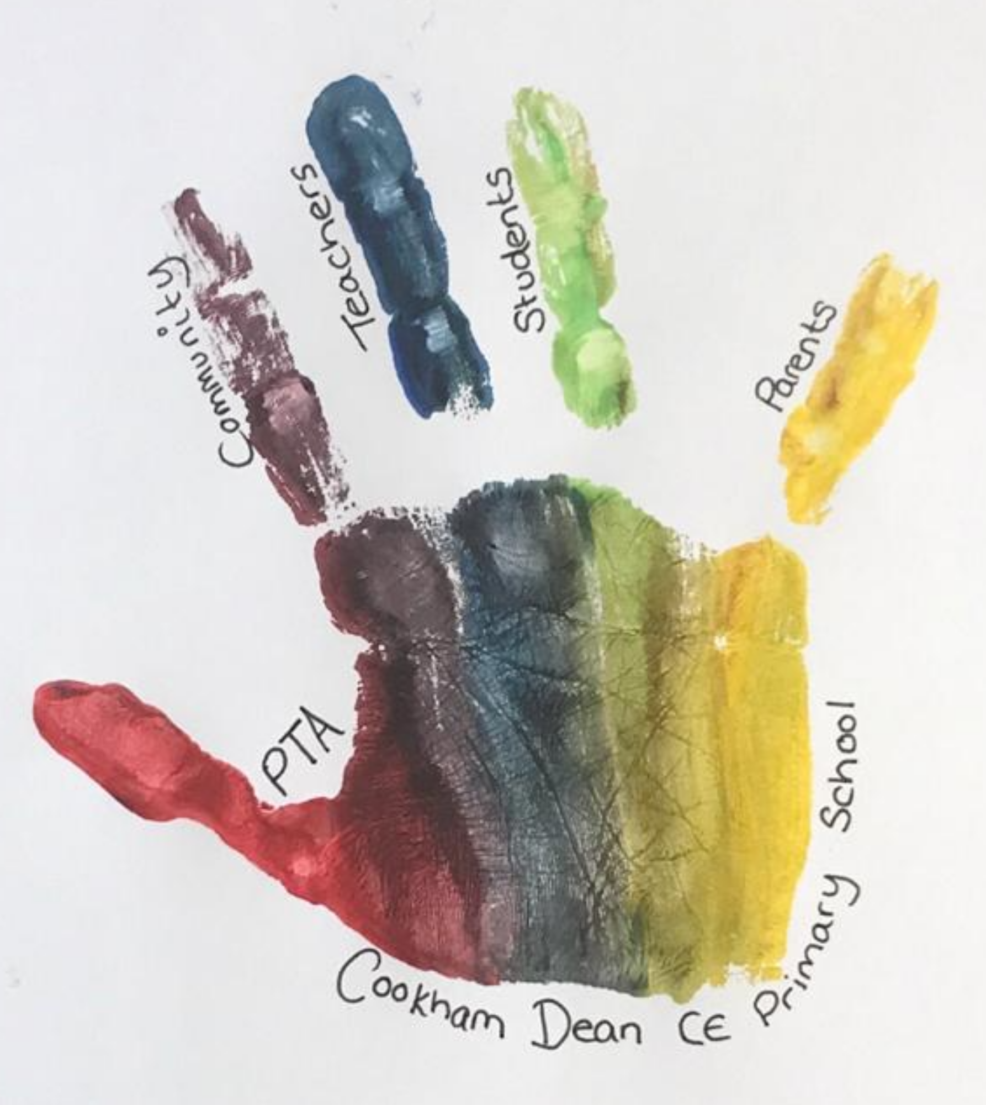
PTA
What is the PTA?
  A charity set up to raise funds on behalf of the school
  Cookham Dean PTA raises more than £25K / year
  We help to bridge the ever-expanding gap in the budget
  We run events that are a fun way for the children to spend more time together, we are fostering a community for us all to flourish
What do we fund?
  Essentials – the curriculum subscription
  Learning tools – the aircon & green screen
  Enrichment activities - theatre company visits & school trips
Why get involved?
  We've built a community of dedicated parents across multiple year groups – we love a good pub stop to organise an event!
  Every child in the school benefits from the funds raised in a meaningful way
  How to get involved?
  Come and chat to us tonight – or ask your class rep (Isadora & Vicky)
  Get involved with volunteering at events
  Ask your work about match funding
  Sponsor our events if you own a business
  Sign up to the VCF
  Follow us on Instagram

Slide 7

Our Reception Team
Ms Fernandez– Class Teacher
Ms Smith – Teaching Assistant AM
Miss Gilbey – Teaching Assistant PM
Miss Windle – Every other Monday Teacher

Slide 8
Transition
12th July – 9.30 till 12 (30 minute sessions)
^{4th} September – 9.15 – midday A-H
^{5th} September – 9.15 – midday I-Z
^{8th} September – 9.15 – 1pm A-H
^{9th} September 9.15 – 1pm I-Z
^{10th} September 9.15 – 1pm all children
^{11th} September 9.15 – 3.15 all children
^{12th} onwards 8.45 – 3.15 all children

Slide 9
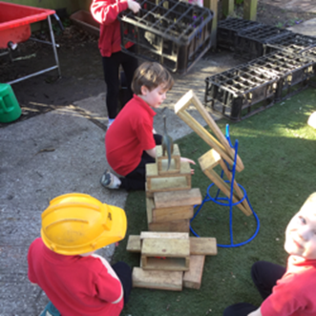
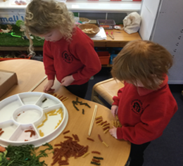
The First Few Weeks
Getting to know each other.
Getting to know the classroom.
A range of familiar activities.
Phonics starts in week 2.
Notes:
This will include showing children where to put their book bags, their coats, wellies, lunch bags etc and helping them adjust to the new routine.

Slide 10
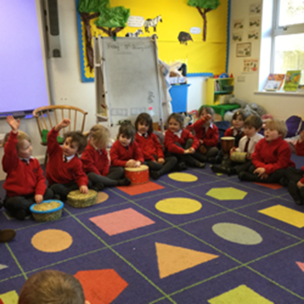
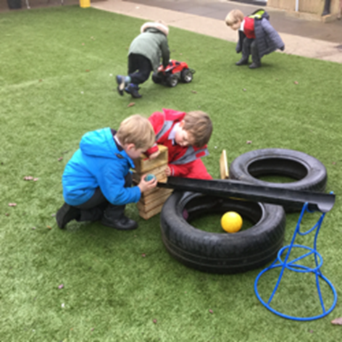
Statutory baseline
assessment
If you have any concerns
please come to speak to us.
Notes:
It is really useful for us to have a copy of your child’s final report from nursery.
We want the transition to a happy one and generally find that this works best if the routine of saying goodbye at the door is established as soon as possible
If you have any concerns about how your child is settling, please come to speak to us.

Slide 11
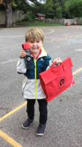
What does my child need at school?
Coat- can leave a water proof coat at school
Wellies- please leave these in school
Book bag
Water bottle- We can fill it at school

Slide 12

E.Y.F.S
EYFS curriculum September 2021
At the end of Reception we assess against 17 early learning goals
They will have started on this journey in their pre-school provision.
Based on the recognition that children learn best through play and active learning.
More information online or on our class page
Notes:
New curriculum designed to improve outcomes at age 5 and reduce unnecessary paperwork – no longer need to evidence everything but emphasis on techer being with the children not doing paperwork.The children will be guided towards achieving 17 early learning goals divided up into different areas of the curriculum.
They will have started on this journey in their pre-school provision.

Slide 13
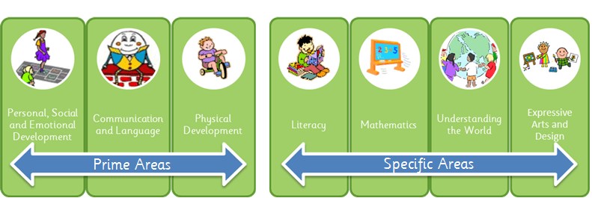
The EYFS Curriculum

Slide 14
How do we learn?
‘What children learn is important, but how they learn is even more important…’
How Children Learn (Nancy Stewart 2011), Helen Moylett

Slide 15
The way we work in Reception
We are ‘led by the child in the moment and we respond accordingly’
Anna Ephgrave 2018
Blended approach - objective led which is within teacher led sessions and elements of planning in the moment during continuous provision
Unique child, unique experience, unique moment
When children are deeply engaged, their brain is developing and they are learning

Slide 16
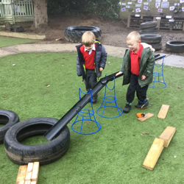
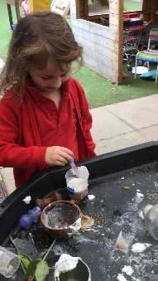
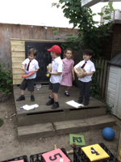
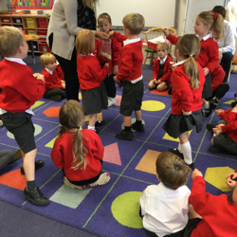
How do we do this?
The curriculum is delivered through a balanced provision of activities, these are…
An enabling and exciting environment
child initiated activities
adult led activities
group work
partner work
school trips
forest school
school visitors

Slide 17

How we share your child’s learning
As we assess and move children's learning on ‘in the moment’ not everything gets recorded. This means teachers are able to spend quality time with your children.
Selected pieces of work that the children do will go into their learning journals.
We will use Class Dojo to share important moments of your child's learning with you as well as class stories and events – parents are encouraged to share experiences and achievements/interests to build the wider picture of the child.
Notes:
Most of the work that the children do will go into their learning journals.
You will get the chance to look at these during ‘Express’ sessions at the end of topics.
We will also send home ‘observations’ termly – photographs of your child engaged in different activities – we ask that you talk through these with your child and then return them to school to go into their learning journals.

Slide 18

A Typical Morning
Rolling start from 8.35am
Registration by 8.45am
Phonics Free flow activities outdoors and indoors. Observation and assessment in the moment.
Snack (fruit and water/milk available all morning)
Teacher led whole class session – Maths
Lunch at 12pm
Notes:
Where to drop off?
Snack -may be either self-regulated or as a group to feedback on activities that children have been doing

Slide 19

A Typical Afternoon
Registration 1.10
Curriculum input Free flow indoor and outdoor activities Observation and Assessment in the moment Teacher led activity –Story/Talk time
R.E – once a week P.E – once a week leading up to twice and the whole class do a daily lap of the running track - there is also physical development everyday during their continuous provision.
Home at 3.15pm

Slide 20

What can I do to help my child?
You can help at home by:
Encouraging dressing skills
Personal hygiene skills and good toilet habits including wiping their own bottom.
Name absolutely everything - especially jumpers/cardigans. If items are named they always make their way back!
Notes:
Preparing children for the morning transition – tears are completely normal and children to bounce back very quickly once inside and into a routine.

Slide 21

Home-School Communication
Member of staff at the door to welcome children daily
Communication whiteboard – reminders, current interests and notices
Class Dojo Updates
Yellow Reading Record books
Email school office
Telephone school – 01628 482734
Text message service
School Weekly newsletter
School website – class page

Slide 22
Uniform
Formal Uniform
Casual uniform
Goyals
2nd Hand Uniform

Slide 23
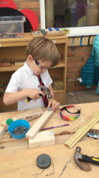
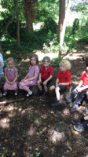
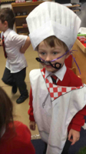
Finally…
Welcome to our school!

Slide 24

Do you have any questions?
Don’t forget your packs!

