Slide 1

Year Ahead 2025-2026
15th October 2025

Slide 2
Introductions
Governors – Chair of Governors Mrs Claire Phillpot
Headteacher – Mrs Fenella Reekie

Slide 3


Slide 4

Voluntary Aided School
Church of England
(Diocese)
Royal Borough of Windsor and Maidenhead
(rbwm)

Slide 5

Who appoints us
Parent Governors (2)
Parent vote
LA Governor (1)
rbwm
Headteacher
(1)
Foundation Governors (8)
Diocese
Staff Governor (1)
Staff vote
Associate
Governor (1)
Deputy Head

Slide 6
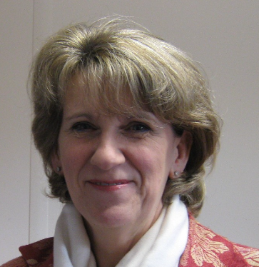
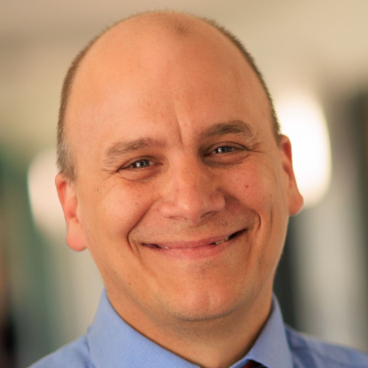
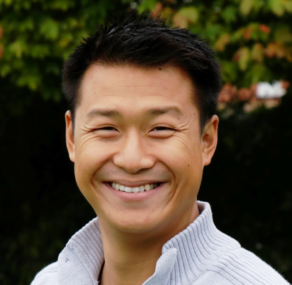
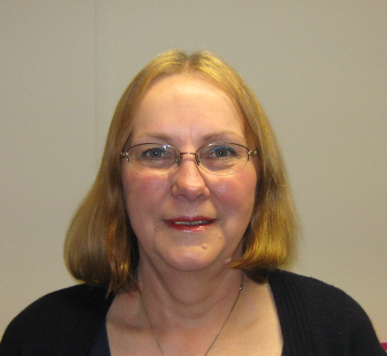
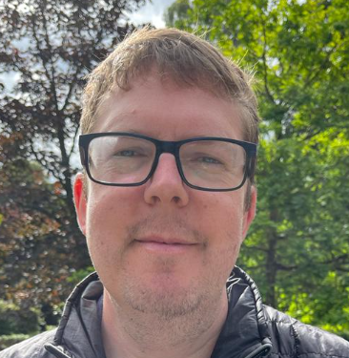
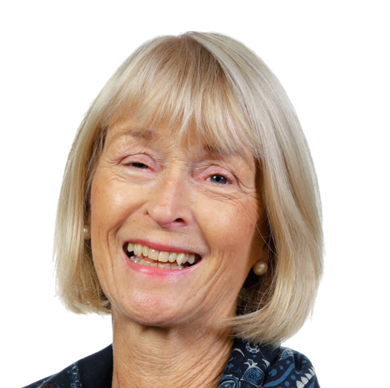
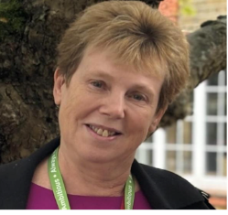
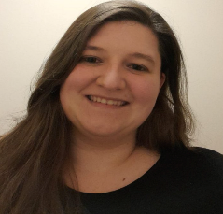
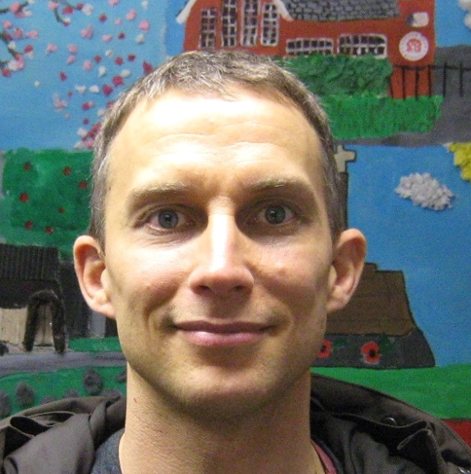
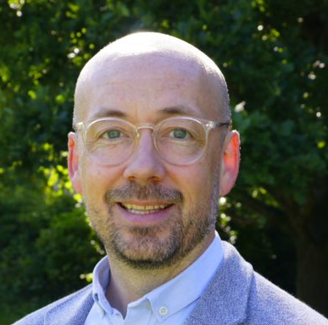
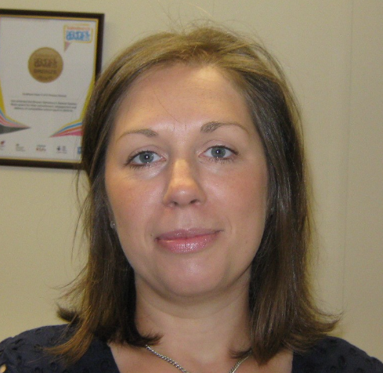
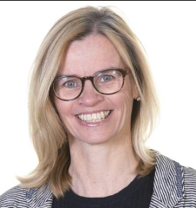
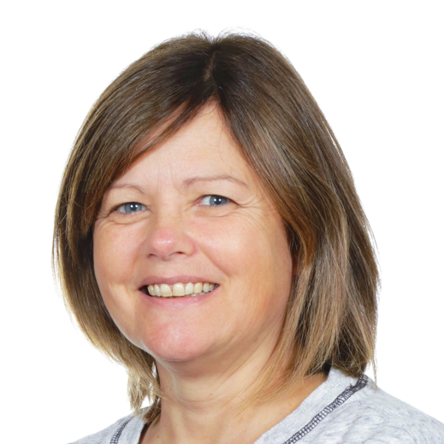
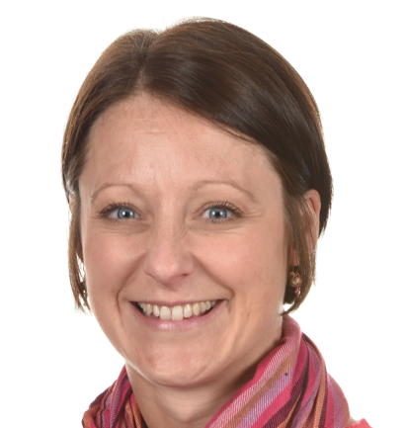
Introducing your Governors
Claire Phillpot
Neil Strain
Adrian Lee
Lorna Sykes
Tony Baker
Heather Oliver
Jane Girle
Rev Sophie Troczyncska
Tim Green
Dan Pearson
Olivia Burton
Fenella Reekie
Nicola Thompson
Carys Windle
To find out more about your Governors, see our revamped page on the website: https://www.cookhamdean.org/meet-the-governors/
SBS = School Business Services SEN = Special Educational Needs PP = Pupil Premium

Slide 7
How we operate
Full Governing Board
School Business Services
Curriculum Committee
Admissions
4 meetings a year
6 meetings a year
6 meetings a year

Slide 8

Further roles
Link
Link
Safeguarding
EYFS
SEN and PP
Literacy
PSHE
Music
Geography
Maths and Science
Health, Safety and Sustainability
Computing
Art and DT
PE
Equality and Diversity
History
Mental Health
RE

Slide 9

Our responsibilities
Ensuring the school has a clear vision, ethos, and strategic direction
Holding the headteacher to account
Managing finances
Ensuring a balanced curriculum
Reviewing progress
Monitoring of the school's educational performance, pupil safety, and staff performance management
All money is well spent and that the school's financial performance is sound
Towards our aims and objectives
Broadly based for all pupils

Slide 10

Our Vision
Develop emotional and spiritual resilience through living out our Christian values
Children feel accepted, loved, affirmed and fulfil their academic potential
Develop skills and enthusiasm as lifelong learners
Where we all flourish

Slide 11
Our Strategic Direction
Aspirational outcomes
Passion for learning
Spiritual and emotional well being
Accountability
High expectations and ambition for all in our community to achieve their full potential
Curious, motivated, inspired pupils who have a positive sense of self as a learner
Pupils are spiritually and emotionally resilient and meaningfully reflective about their well-being and that of others
A collaborative team that challenge and support each other with trust and respect for the benefit of all
Where we all flourish

Slide 12
P
R
O
G
R
E
S
S
Aspirational outcomes: Set ambitious targets that will be achieved through an engaging curriculum and a wide range of opportunities
Passion for learning: Consolidated high quality structure and process to enable staff to nurture and enthuse each individual pupil according to their needs
Spiritual and emotional well being: The values pyramid is reflected in pupils’ learning and experiences
Accountability: To continue to develop the skills and understanding through professional development opportunities to strategically lead the school to success

Slide 13
Monitoring
Full Governing Board meetings
Curriculum and SBS meetings
School Development Plan
School Evaluation Plan
Headteacher reports
Pupil progress meetings
Link governor meetings and reports
Senior Leadership Team learning walk
Pupil voice
Professional Development Meetings
Performance management
Pupil, parent and Staff Questionnaires
Parish and Community engagement
Senior Leadership action plan
Training programme

Slide 14


Slide 15
Where we all flourish
Curriculum
6Rs
Enrichment programme including our sports programme
Extensive extra curricular programme
Church and our Christian Values
Emotional support
Staff training
Teamwork
PTA support
Opportunities for leadership

Slide 16
Our school values
Our School is
a family of learning at the heart of the community.
It is built on our Christian Values of
friendship, community, joy, peace, trust, endurance and forgiveness that help us:-
· Care and share
· Create a safe, happy and friendly place
· Encourage curiosity and creativity
· Nurture children and staff for their journey through life
· Develop responsibility and respect
· Inspire the very best in all of us

Slide 17
Behaviours for Learning
6Rs
Responsibility
Ready
Resilience
Resourcefulness
Respect
Reflective

Slide 18
Results from Summer 2025
Year 1
Phonics assessment – 75% - 7 children did not pass(national average 81%)
KS2 SATS
Reading school data 100% (national data 75%)
Writing school data 92% (national data 72%)
Maths school data 83% (national data 74%)
SPAG school data 83% (national data 73%)
Combined score 79% (national data 62%)

Slide 19
Results from Summer 2025
KS2
Greater Depth
Reading school data 57% (national data 33%)
Writing school data 4% (national data 13%)
Maths school data 32% (national data 26%)
SPAG school data 35%

Slide 20
Ofsted– Good June 2022
  Pupils feel happy and safe
  Pupils say the vision is at the heart
  Children in early years get an excellent start
  Every pupil is expected to achieve highly
  Pupils behave well
  Pupils say that staff take all reports of bullying seriously
  Pupils know that overcoming challenges brings a positive sense of achievement
  Pupils get off to a good start with reading – leaders have introduced a new phonics scheme in 2021
  Pupils in KS2 speak positively about reading
  The personal development of pupils is very important in this school

Slide 21
Ofsted – Good
Curriculum planning provides clear information on essential knowledge that pupils need to know
Curriculum leaders have secure knowledge about their areas of responsibility – they share their expertise so that everyone feels supported to teach well
Teachers are skilled in helping pupils individually when needed
Governors are very ambitious for pupils’ academic and social success.
Staff are proud to work at the school
Staff put a great deal of time and effort into building and maintaining trusting relations with parents and carers.

Slide 22
Areas for development
In a few of the foundation subjects, the work given to pupils is not as demanding as it could be
Actions to date
Teachers have been trained in creating engaging independent learning tasks based using AI
Focus on not being reliant on worksheets
Fulfilling enrichment programme in place
High expectations of presentation, handwriting across every subject
Extensive training programme on pedagogy for all teachers

Slide 23
Priorities for this year
Supporting those children and families with low level behaviour issues
Ensure high quality teaching and learning of reading from year 2 -6
Further develop our provision for SEND
Improve outcomes for writing at greater depth
Prepare for ofsted visit under the new framework
Achieve the platinum Opal award

Slide 24
Ensure that all new children are settled and welcomed into our school
Further enhance the relationship with school and the new vicar and church
Build an outside classroom area
Develop the forest school area
Priorities for this year

Slide 25
SIAMS– Outstanding
Leaders, including governors, make bold decisions inspired by the Christian vision. Consequently, pupils and adults flourish as unique individuals because of dedicated leaders’ commitment to providing the best possible opportunities for personal development.
• The inclusive curriculum is designed with the vision at its centre meaning pupils benefit from the wide range of experiences it offers. Leaders provide tailored support so that the needs of learners considered vulnerable are well met.
• Collective worship is valued by staff and pupils as a meaningful time to come together. It is deeply rooted in the vision and associated values of the school and enhances its spiritual life.
• Leaders actively create a strong culture of care and respect built on positive relationships. Pupils and adults feel valued and listened to with their feedback resulting in positive developments. Beneficial, collaborative partnerships enhance the wellbeing of members of the school and the wider community.
• Through effective leadership, the religious education (RE) curriculum is thoughtfully sequenced. As a result, pupils develop knowledge of a range of worldviews and appreciate diversity.

Slide 26
Areas for Development
Extend opportunities to embed spiritual development throughout the curriculum. This is so that pupils can broaden their experiences of reflecting on themselves, others and the big questions of life.
Enhance pupils’ understanding of how to challenge injustice. This is so that they recognise how they can actively make a positive difference to the lives of others.
Further strengthen learning opportunities in RE so that pupils can explore their understanding in different ways. This is so they can make connections that deepen their understanding of the ways faiths and worldviews are lived out.

Slide 27
Actions to date
Isingpop – another great success with concert in church
Prayer Space being organised for this term
Families@4 increased attendance
Pupils4Praise – a group of year 6 that work with Mrs Thompson (RE lead) to develop reflective garden area

Slide 28
Attendance
Updated guidance August 2024 for attendance
Key points
Good attendance is everyone’s business
The foundation of securing good attendance is that school is a calm, orderly, safe, and supportive environment where all pupils want to be and are keen and ready to learn.
It is the legal responsibility of every parent to make sure their child receives that education either by attendance at a school or by education otherwise than at a school.
Where parents decide to have their child registered at school, they have an additional legal duty to ensure their child attends that school regularly. This means their child must attend every day that the school is open, except in a small number of allowable circumstances such as being too ill to attend or being given permission for an absence in advance from the school.

Slide 29
Attendance
Penalty notices
Schools must consider issuing a penalty notice if a student misses 10 or more sessions (equivalent to five days) for unauthorized reasons within a 10-week period.
Attendance contracts
The term "parenting contracts" for attendance has been changed to "attendance contracts" to better reflect the agreement between parents, schools, and/or local authorities.

Slide 30
Attendance
School culture
The guidance emphasizes the importance of working with families to improve attendance and the link between attendance and school culture.
Support for pupils
The guidance provides details on the support that should be provided to families and pupils who are persistently or severely absent.
Legal interventions
The guidance provides details of the legal interventions available to schools and local authorities when attendance support does not work.
The national expectation is that children's attendance is 96% or better.

Slide 31
Physical and Mental Wellbeing
Physical wellbeing continues to be a focus for school – sports ambassadors leading OPAL activities at lunchtime for all children
A variety of after school clubs (tennis, football, netball,rugby, running club, yoga, kickboxing and gym club)
Use of the running track as part of curriculum
Competitions and festivals (as part of our SLA with Schools Sports Partnership) –So far we have taken part in year - Year 2 Active 60, KS2 running, netball matches,
Participation sheets to ensure that all children across the year take part
Professional coach to accompany children to competitions (where appropriate and possible)

Slide 32
Physical and Mental Wellbeing
Leadership opportunities for children – sports ambassadors and sports organising crew.
Silver KS1 Active Stars Award received 2025
School games award – Silver achieved in 2025
1 TA trained in ELSA – with 2 more to be trained in January
Pupil emotional wellbeing ambassadors trained
Nurture group up and running trained nurture practitioners
Attachment Aware Schools Award – Gold award achieved 2025
Brain breaks after every transition
Thorough PSHE curriculum (personal, social, health education) – relationships education is now compulsory
Professional support – EP, Early Help, Play Therapists, Drawing and Talking Therapy

Slide 33
Highlights for this year
Choir singing at the Cookham Arts Festival
Year 4 Dance Festival
Families@4
Football team league
School Council raising money for Trunks across the Thames
Young Shakespeare Company to present Romeo and Juliet to KS2
Year 6 to sing at Windsor Castle
Year 5 3 day trip to Ufton Court
Year 6 6 day trip to Rhosy
Netball team league
External competitions - Lions Maidenhead Talent Show, Magic Mathemagician, Poetry Competition, 500 Big Write, Rotary Writing competition
Neuro diversity celebration week
Healthy Schools Week
Musical Soiree
Charity fundraising – Children in Need, MacMillan, Comic relief
Awareness Days – Children’s mental health day, World gratitude day, Black History month, Remembrance service, NSPCC, Safer Internet Day, Down Syndrome Awareness day

Slide 34
Projects for this year
Outdoor Classroom
Another set of ipads for KS2
More OPAL resources (sandpit/gazebo screens to make it more of a social area)
Decorating the school
New toilets in KS2 and KS1

Slide 35
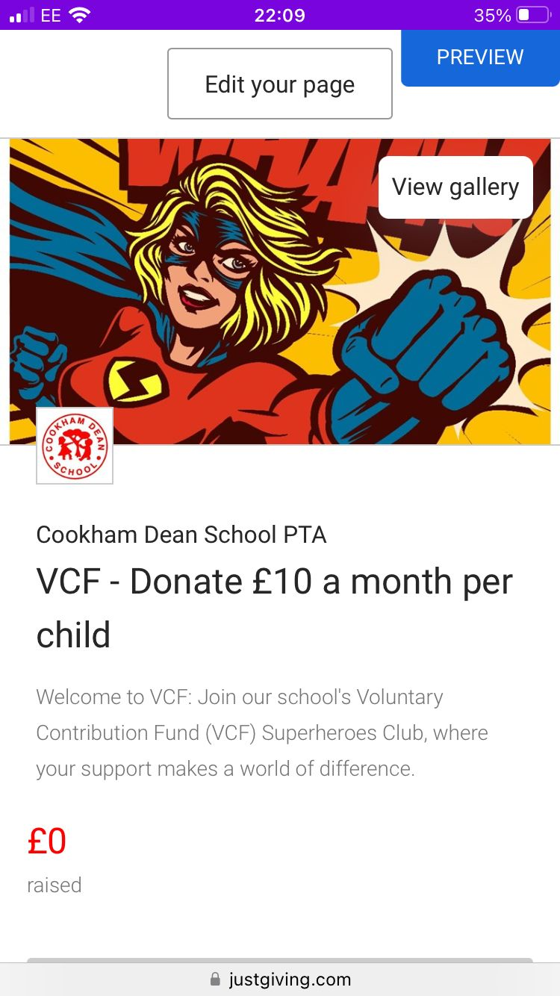
VCF
What is the VCF?
Why do we need the VCF?
What does the VCF get spent on?

Slide 36
What can you do?
Ensure your child attends school every day unless they are ill (see NHS guidance)
Support your child’s learning – hear them read every night, practise spellings/phonics, ensure that research is done in time for lessons, practise times tables
Read the newsletter every week – there is lots of information!
Join the parent forum
Complete the parent questionnaire when it comes out after half term
Sign up to the VCF (Voluntary Contribution Fund)
Join in the PTA events
Come and see me or email me if there is something you are not happy about or are unsure about

Slide 37

Any questions?

