Slide 1

National Trust in Cookham Dean
Michael Andrews, Area Ranger
Cookham Dean Primary Look-ahead 18/10/23

Slide 2
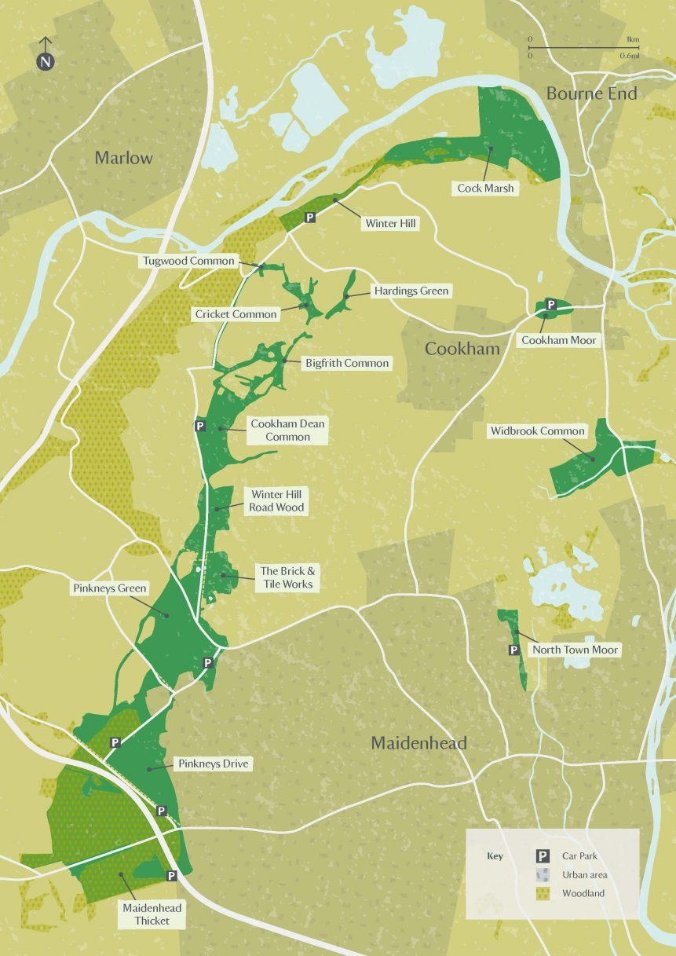
Maidenhead & Cookham Commons (MCC)
Gifted to the trust in 1934
Covers over 843 acres
Includes a variety of habitats, such as chalk grassland, woodland, ponds, and wildflower meadows
As well as verges, village greens and brownfield sites
Looked after by a team of staff and volunteers
Notes:
MMC: Rangers look after this area and have a group of volunteers to help them to manage this site. A lot of the land is Commons land – different to public land with different legislation. Bought by residents in 1920s; sold to NT in 1934.
Some grazed lands still exist.
Verges, village greens, chalklands, grasslands, woodlands

Slide 3
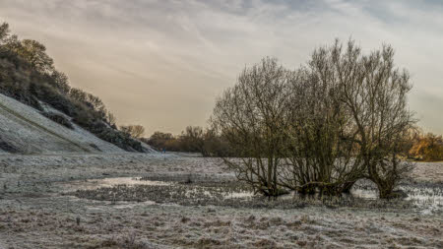
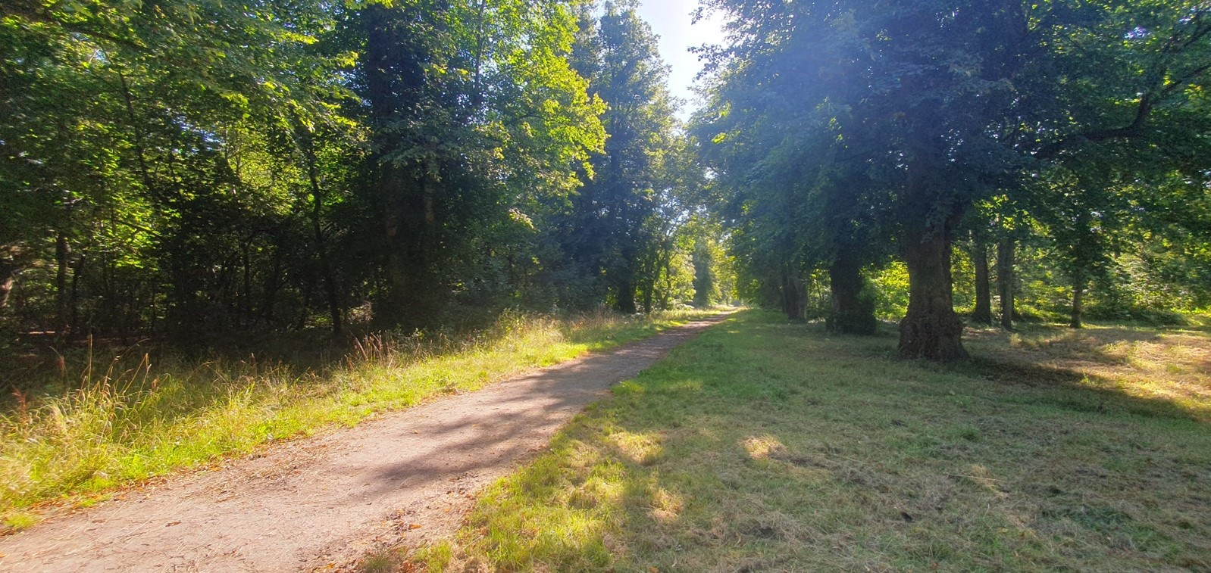
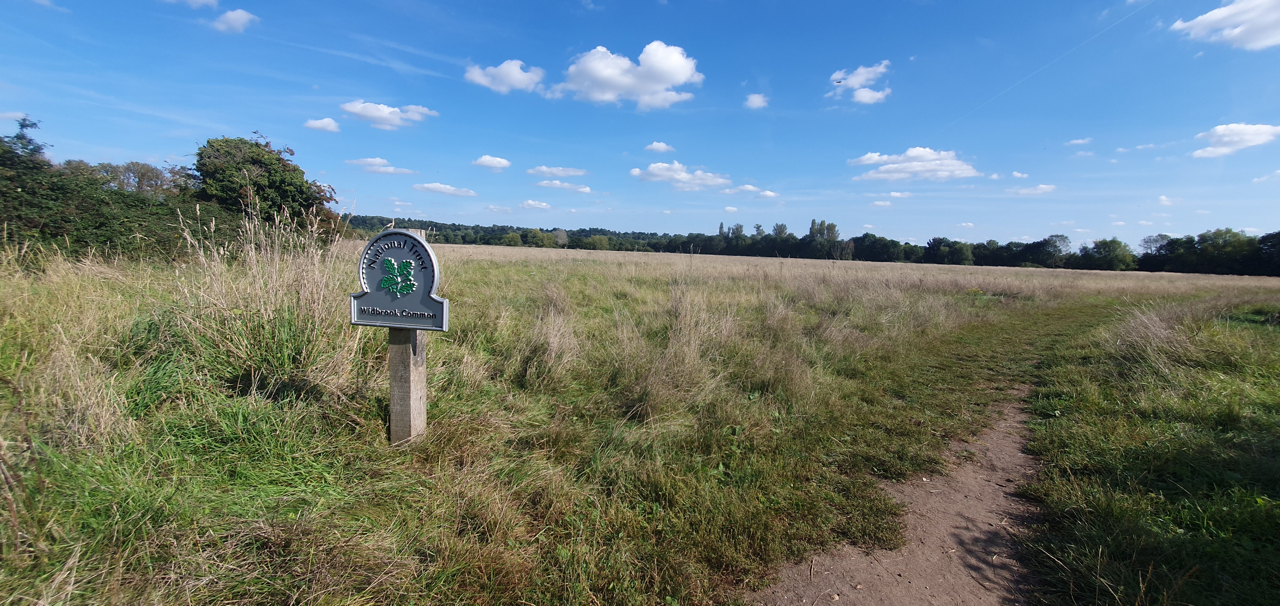
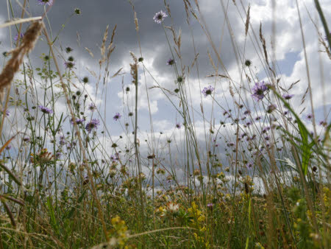
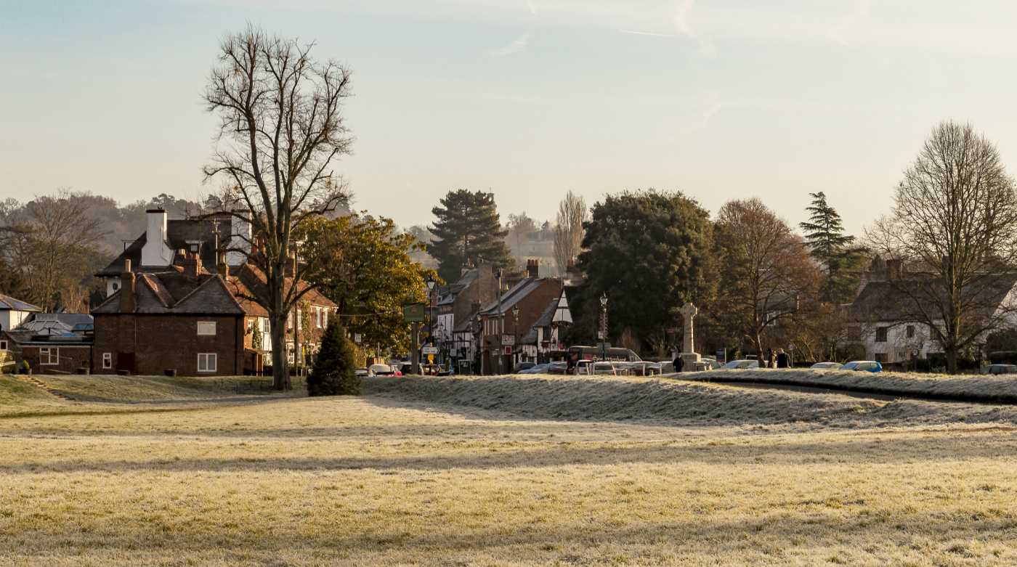
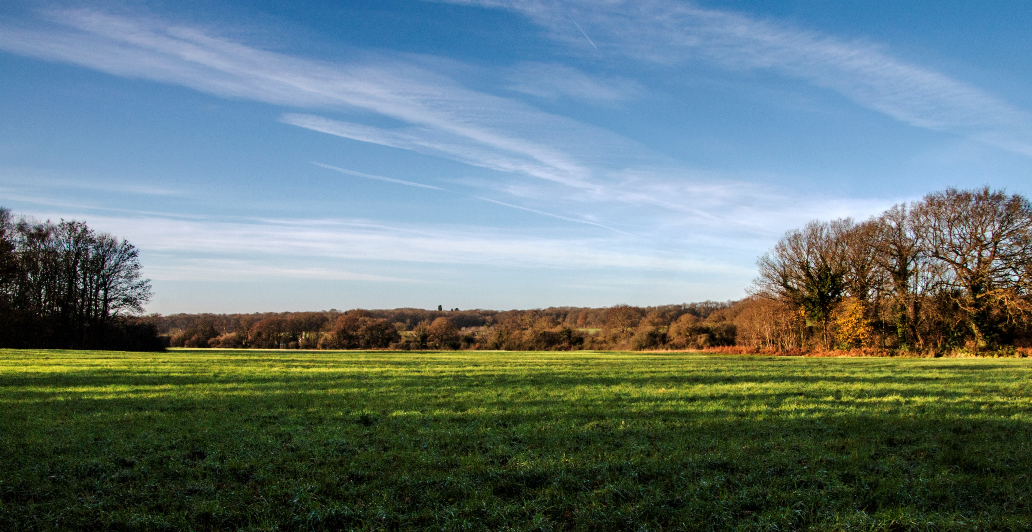
Maidenhead Thicket
Cock Marsh
Widbrook
Thicket Meadow
Cookham Moor
Cookham Dean Common
Notes:
With around 500 acres of grassland and 340 acres of woodland habitat, the commons of Maidenhead and Cookham are home to an abundance of wildflowers and insects.
The Maidenhead commons are a series of commons, stretching from Maidenhead Thicket and Pinkneys Drive in the south, Pinkneys Green, Winter Hill Road Woods and the Brick and Tile Works to the north, and North Town Moor in the east. The commons offer great walking opportunities and a welcome respite from the hustle and bustle of Maidenhead town centre.
Further information taken from website about history:
Maidenhead and Cookham Commons have always been at the centre of local life. Villagers fought for their survival for centuries and played a crucial role in ensuring their protection for ever.
A royal estate
All the land we now know as Maidenhead and Cookham Commons once belonged to the Royal Manor with royal interest in the area dating back as far as AD997 when Ethelred the Unready held a Council of State at Cookham.
Creation of the commons
Within the Manor, areas of poor land were left as ‘common’ land and local people had long-established rights to graze animals and take wood for fuel. By the late 18th century enclosure was happening all over the country and much common land was being wiped out. However in Cookham, local residents determined to protect their ancient rights successfully formed a resistance movement and the Commons were saved.
For ever, for everyone
For centuries, monarchs had leased the estate to both individuals and groups of villagers but in 1818 the land was sold to Mr George Bangley for £5760. A number of prominent local families subsequently owned the estate until the 1920s when a fundraising campaign was begun by local residents to raise the £2800 required to buy the Commons. With the purchase complete, the Maidenhead and Cookham Commons Preservation Committee gave the land to the National Trust in 1934 ensuring its long term future.
The commons today
As you walk through the Commons, you’ll still find local farmers exercising their ancient rights to graze cattle on the land. But today the Commons also provide welcome green, natural spaces for villagers and visitors to walk, ride and play. As well as a sanctuary for people, the diverse landscapes of the Commons are a haven for wildlife and plants which together, all help to preserve the character of these hard-won places.

Slide 4

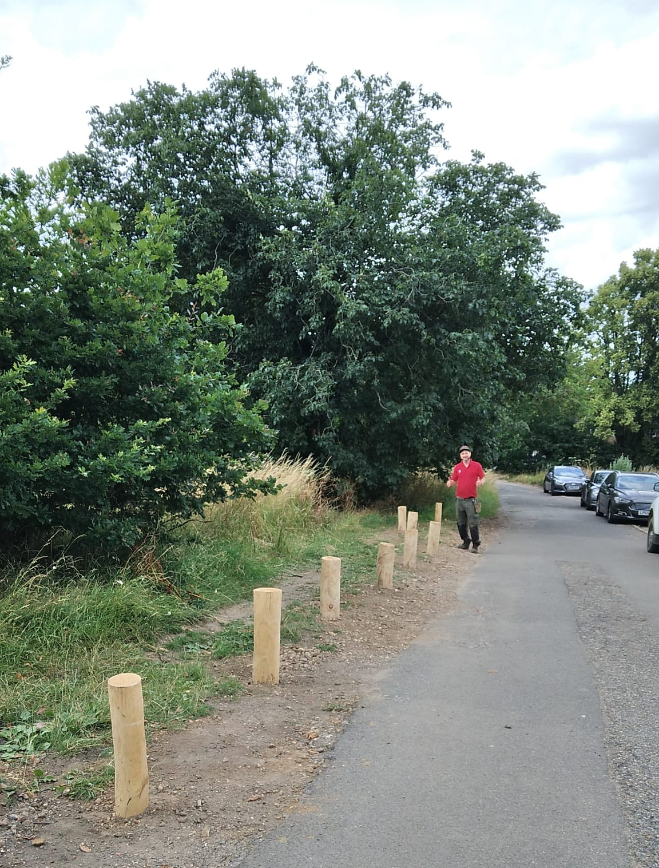
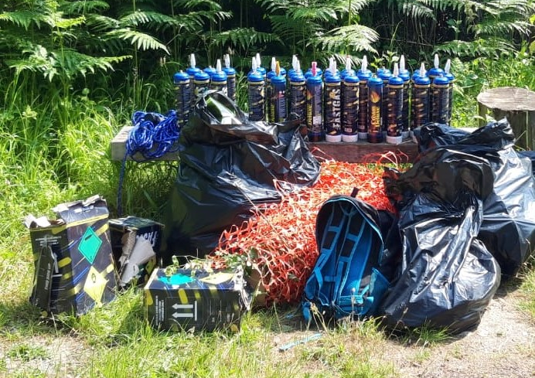
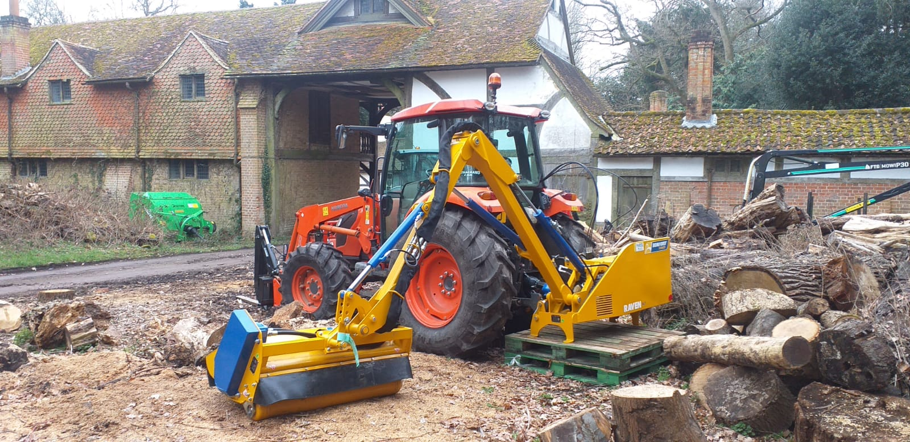
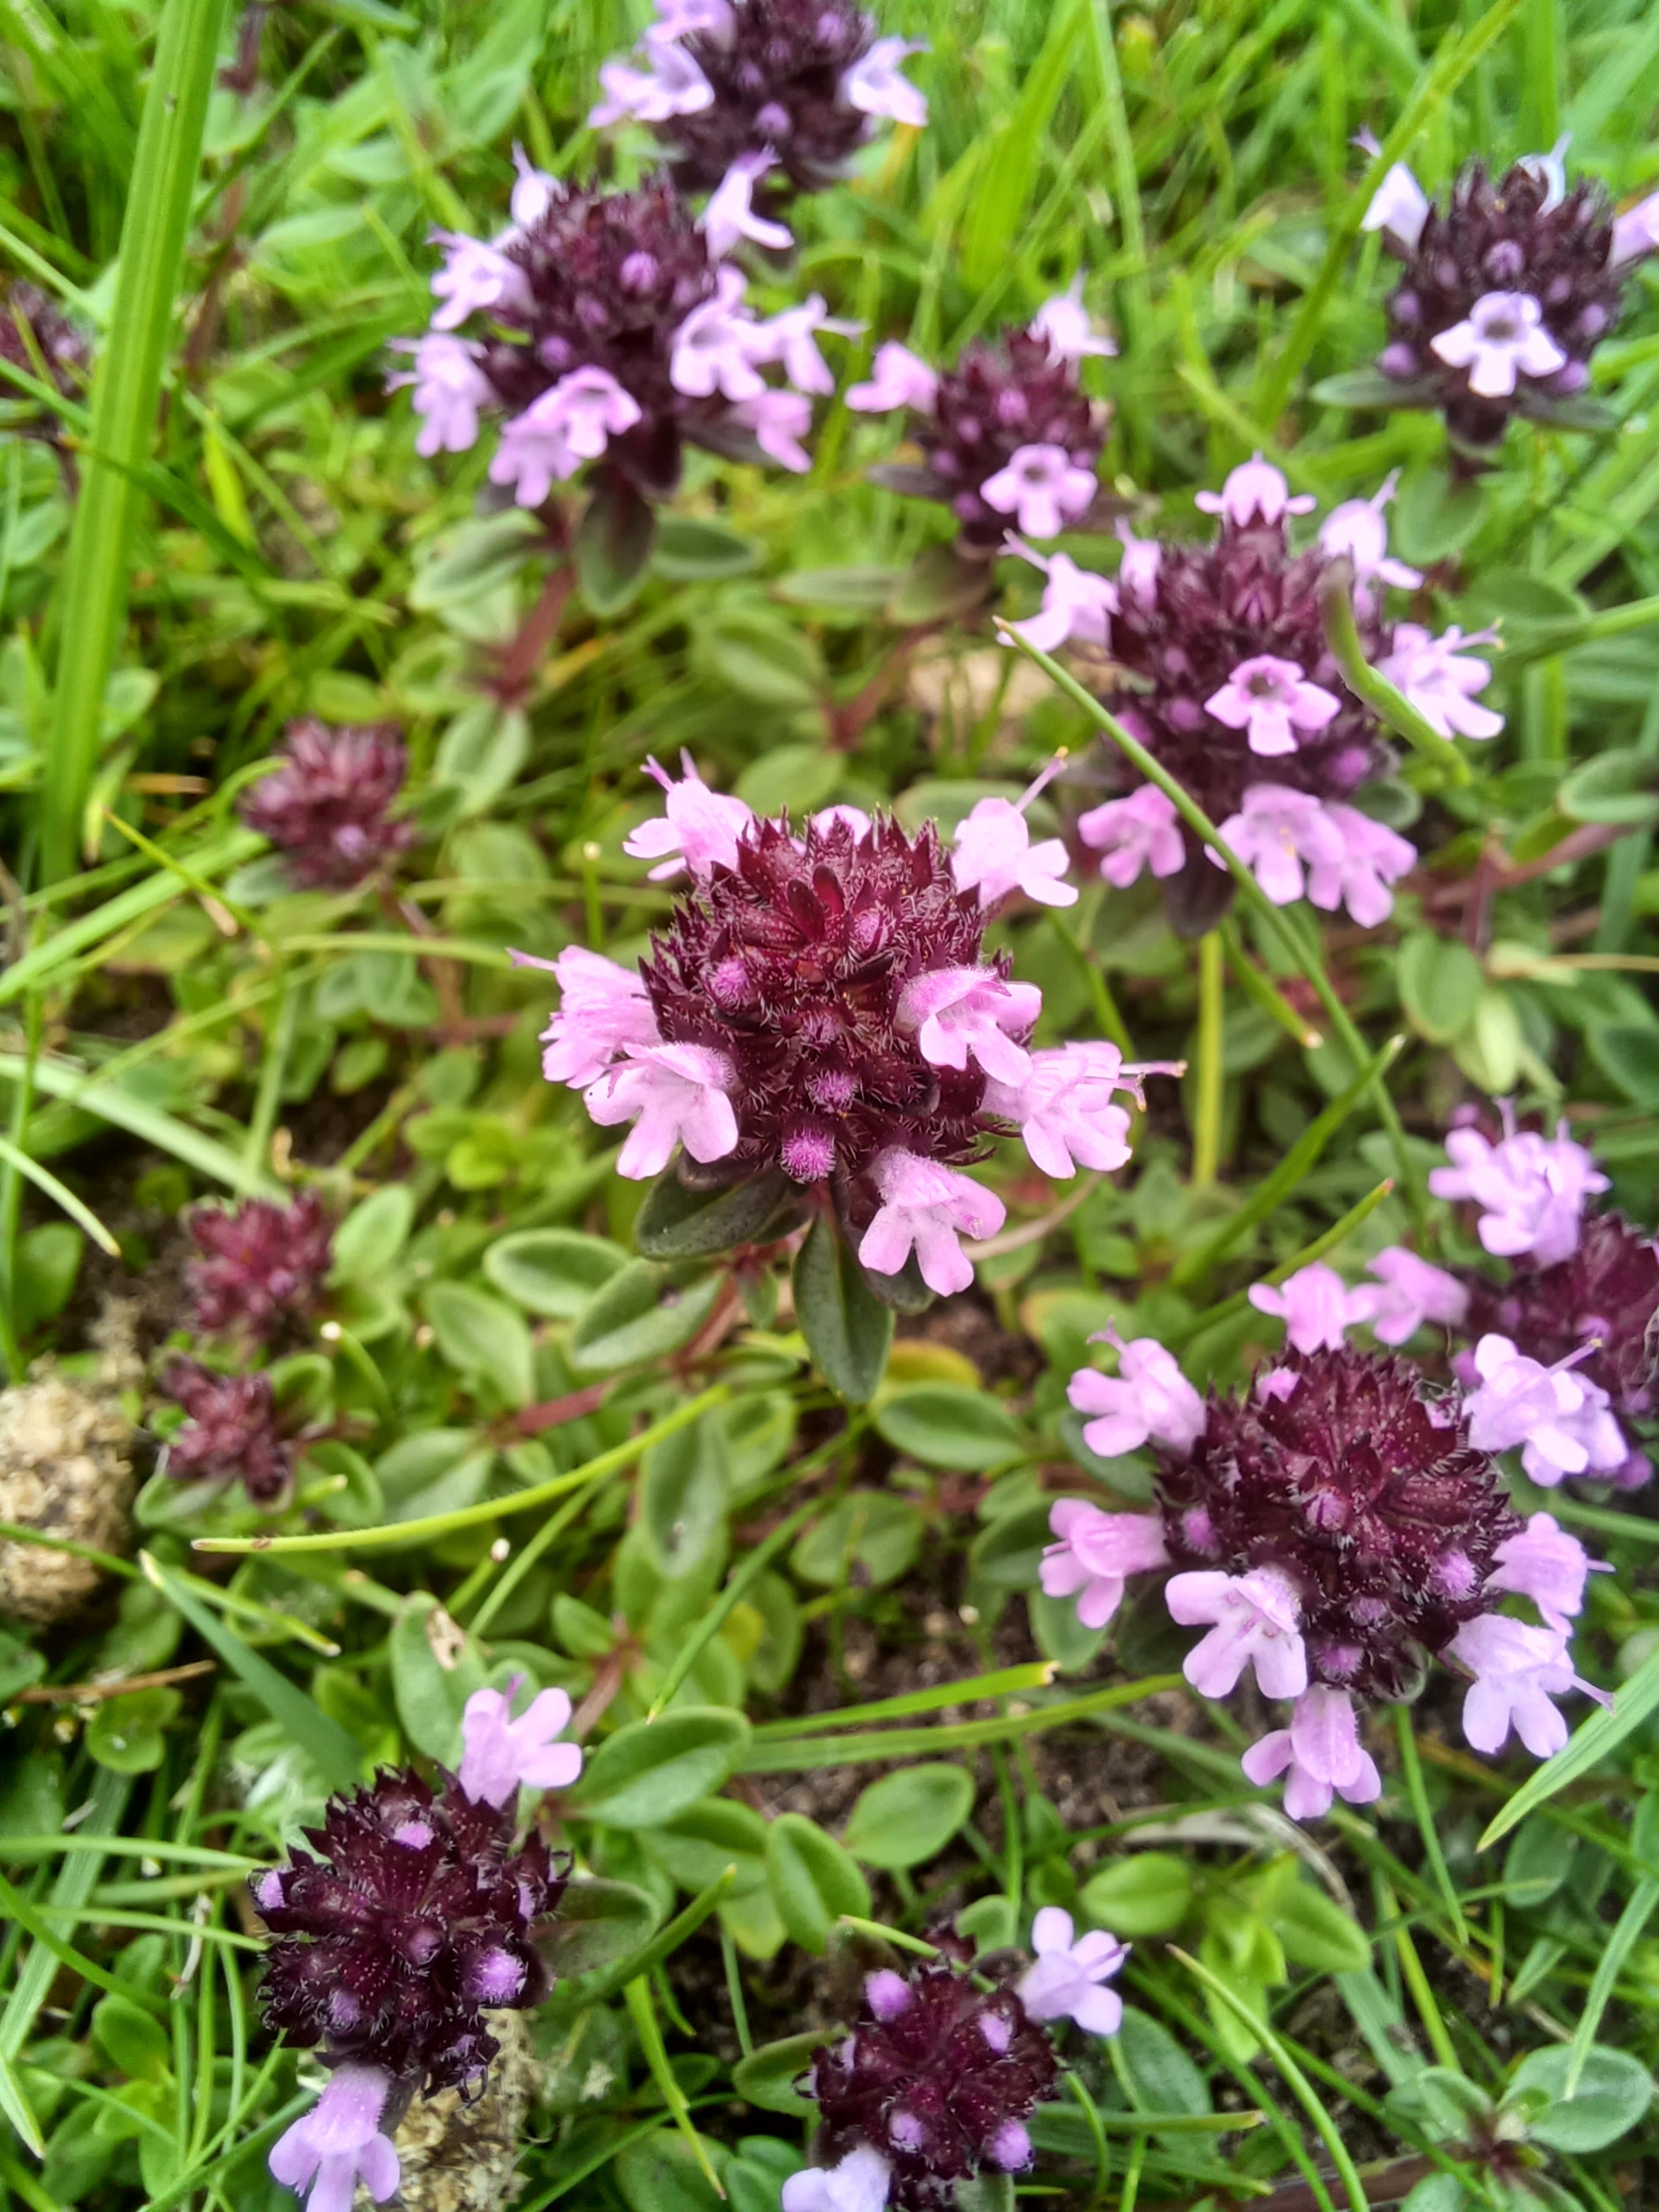
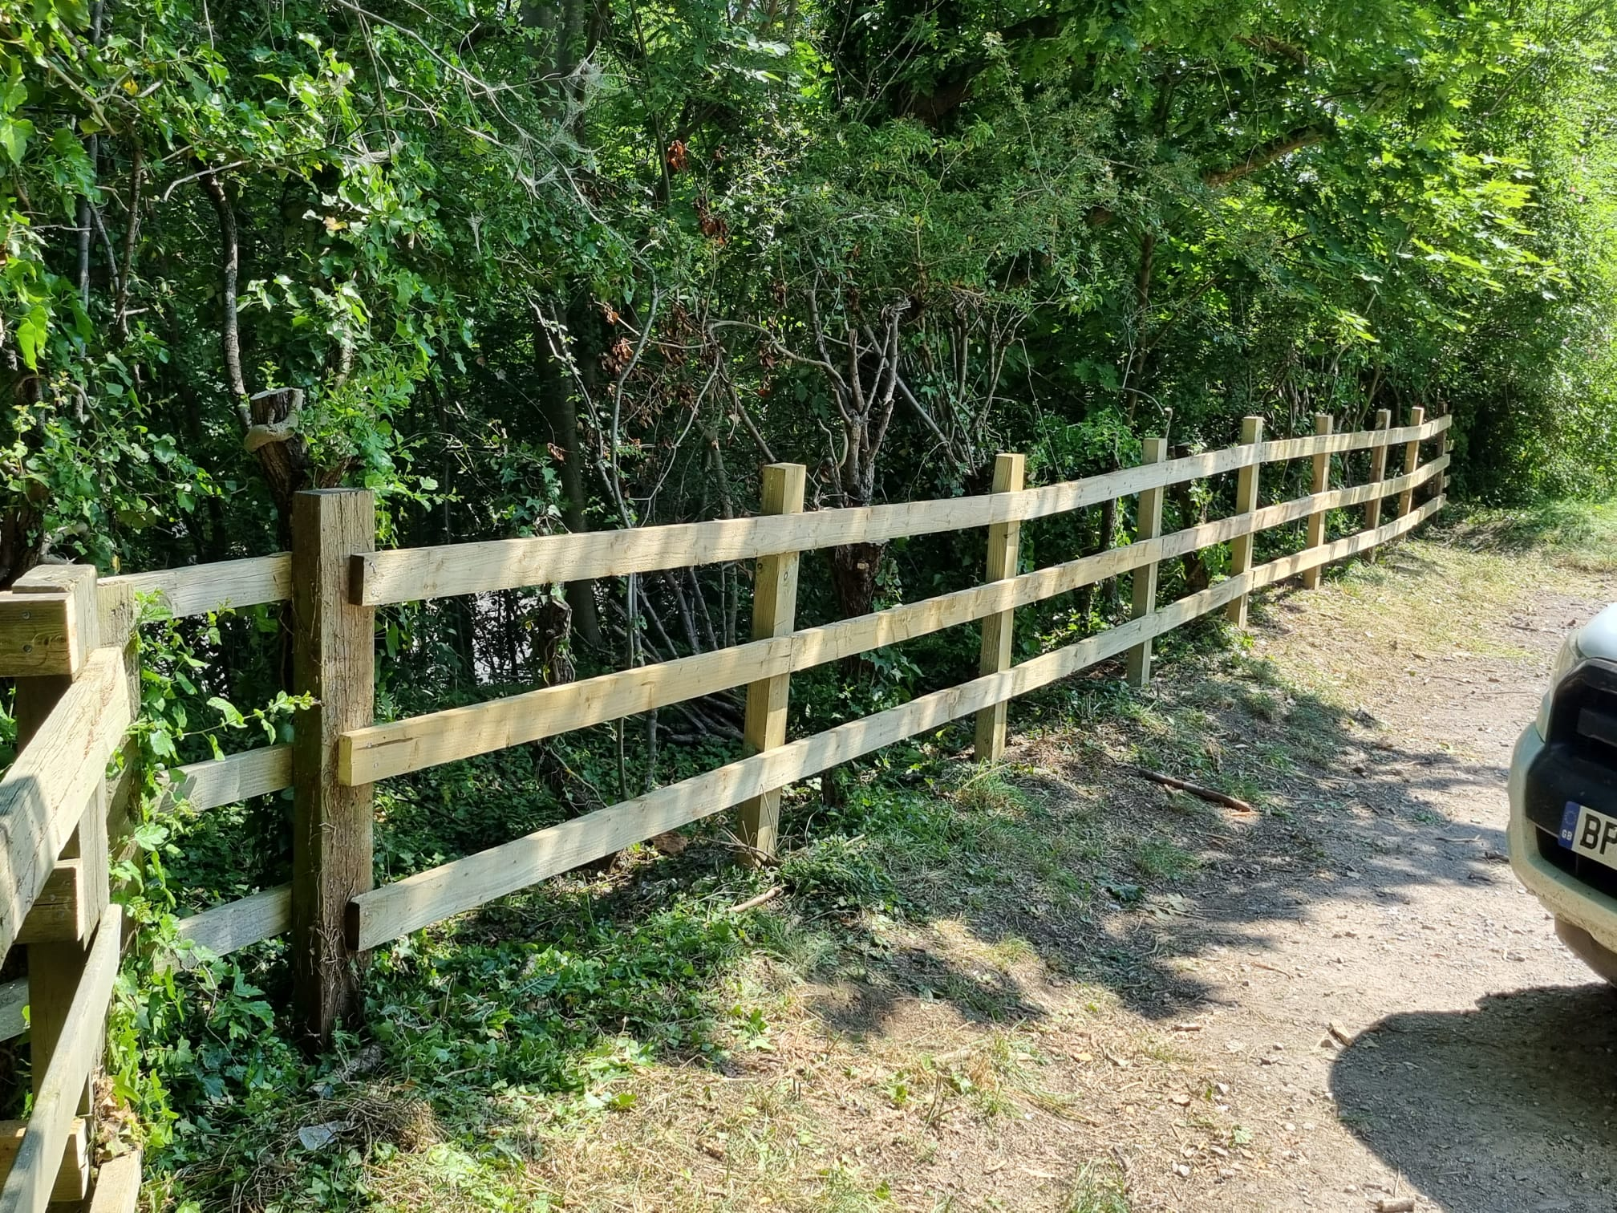
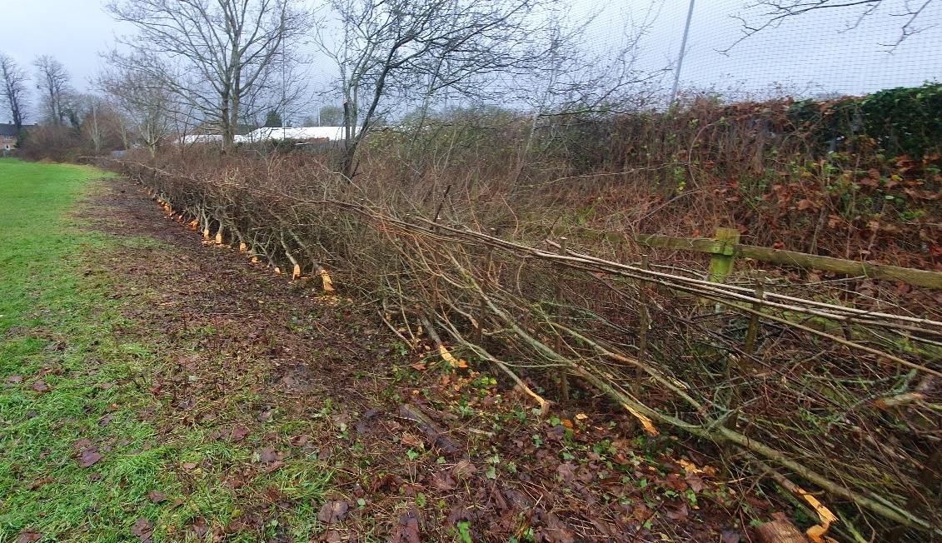
Our Work

Slide 5
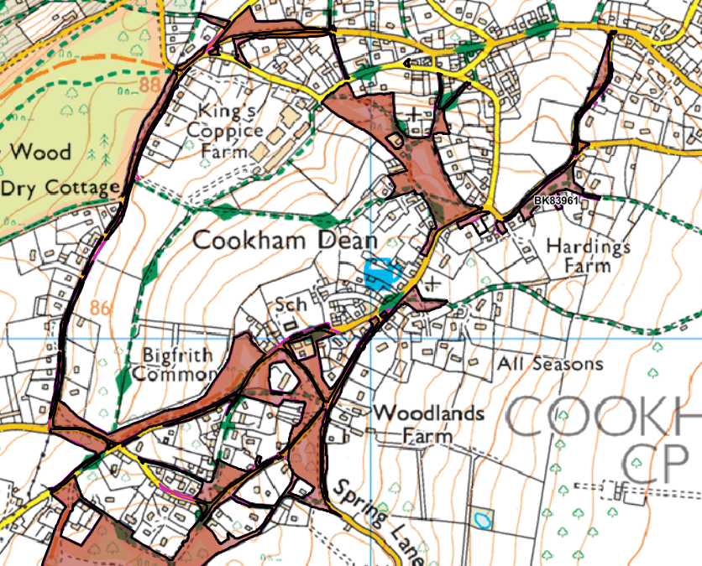
Cookham Dean
Totals 78 acres
A focal area of the Commons
Protect by working together
You are here
Notes:
MMC: Rangers look after this area and have a group of volunteers to help them to manage this site. A lot of the land is Commons land – different to public land with different legislation. Bought by residents in 1920s; sold to NT in 1934.
Some grazed lands still exist.
Verges, village greens, chalklands, grasslands, woodlands

Slide 6
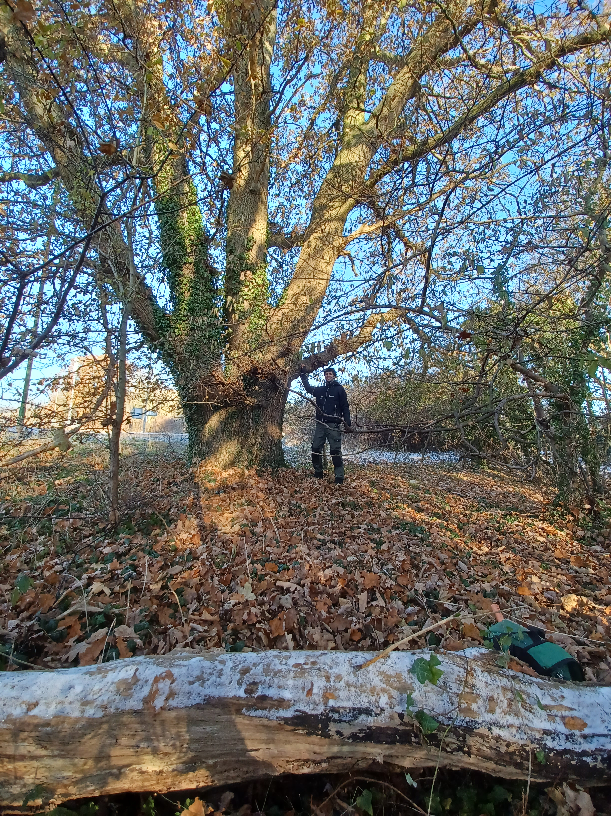
Thank you!
Questions?
phone: 01628 605069 ext. 104
email: maidenheadandcookham@nationaltrust.org.uk

