Slide 1

Year Ahead 2022-2023
9th November 2022

Slide 2
Introductions
Governors – Chair of Governors Mrs Claire Phillpot
Headteacher – Mrs Fenella Reekie
Deputy Head and SENCO – Miss Carys Windle

Slide 3
Our school values
Our School is
a family of learning at the heart of the community.
It is built on our Christian Values of
friendship, community, joy, peace, trust, endurance and forgiveness that help us:-
· Care and share
· Create a safe, happy and friendly place
· Encourage curiosity and creativity
· Nurture children and staff for their journey through life
· Develop responsibility and respect
· Inspire the very best in all of us

Slide 4
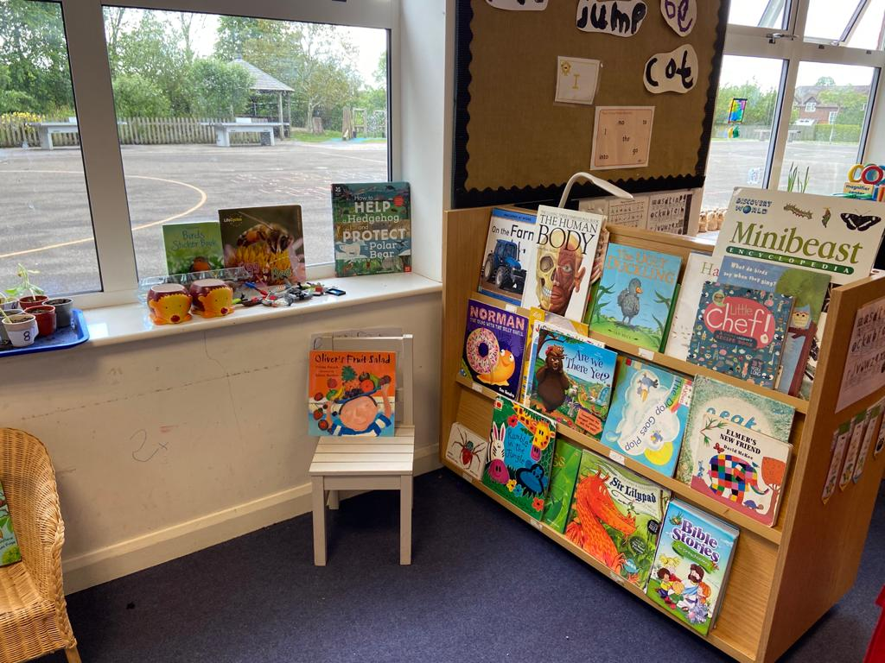
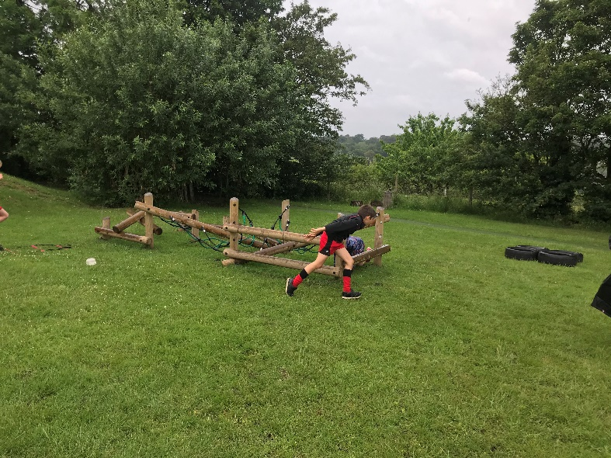
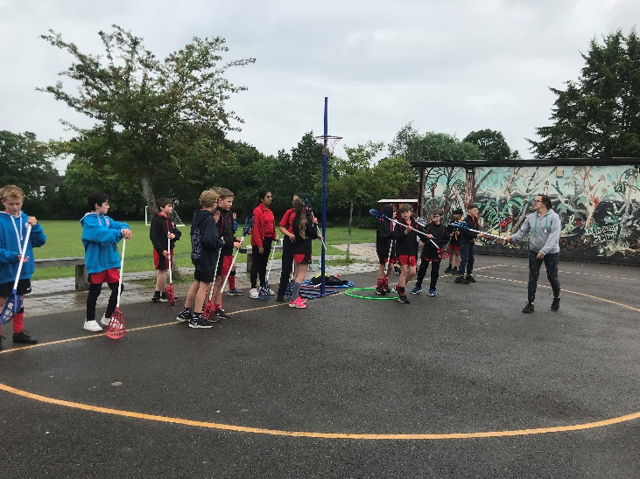
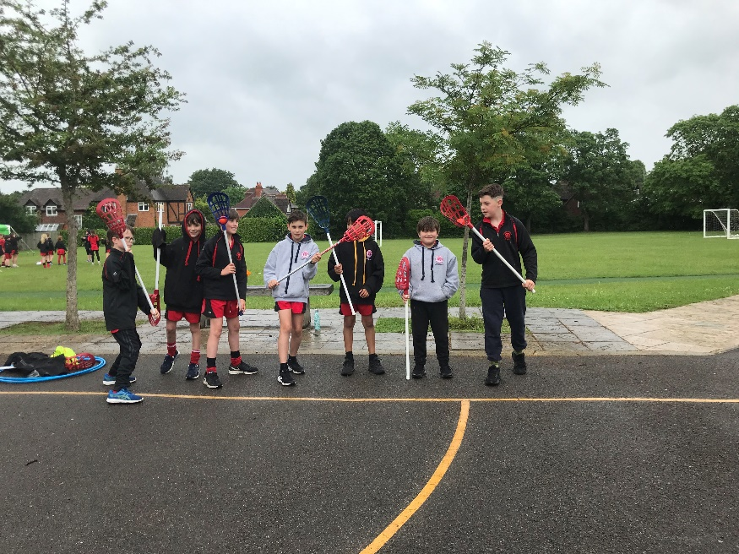
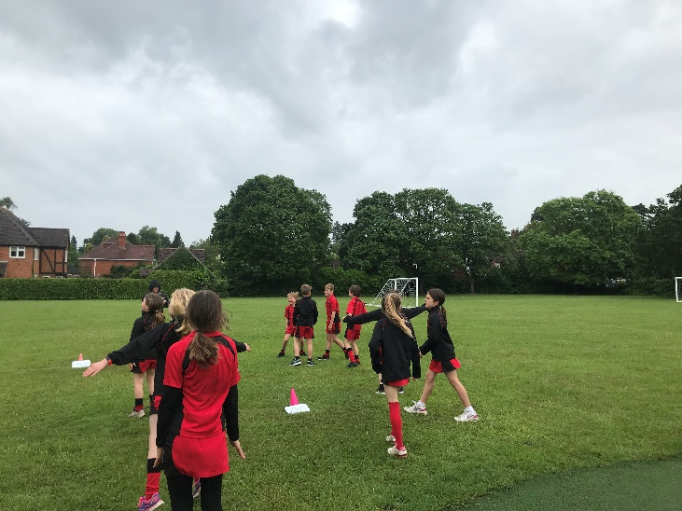
Where we all flourish

Slide 5
The Goals of the Governors’
That all children are accepted, loved, affirmed and fulfil their academic potential
That all children develop skills and enthusiasm as life long learners
That all children develop emotional and spiritual resilience through living out our Christian values

Slide 6
Behaviours for Learning
6Rs
Responsibility
Ready
Resilience
Resourcefulness
Respect
Reflective

Slide 7
Results from Summer 2022
Phonics assessment – 64% school 75% national
KS1
Reading 83% school 67% national (GDS 29% school 18% national)
Writing 68% school 58% national (GDS 4% school 8% national)
Maths 82% school 68% national (GDS 14% school 15% national)

Slide 8
Results from Summer 2022
KS2
Reading 93% school 74% national (GDS 63% school 27% national 2019)
Writing 88% school 69% national (GDS 37% school 27% national 2019)
Maths 93% school 71% national (GDS 44% school 27% national 2019)
SPAG 96% school 72% national (GDS 70% school 20% national 2019)
Combined 86% school 59% national

Slide 9
Ofsted– Good
  Pupils feel happy and safe
  Pupils say the vision is at the heart
  Children in early years get an excellent start
  Every pupil is expected to achieve highly
  Pupils behave well
  Pupils say that staff take all reports of bullying seriously
  Pupils know that overcoming challenges brings a positive sense of achievement
  Pupils get off to a good start with reading – leaders have introduced a new phonics scheme in 2021
  Pupils in KS2 speak positively about reading
  The personal development of pupils is very important in this school

Slide 10
Ofsted – Good
Curriculum planning provides clear information on essential knowledge that pupils need to know
Curriculum leaders have secure knowledge about their areas of responsibility – they share their expertise so that everyone feels supported to teach well
Teachers are skilled in helping pupils individually when needed
Governors are very ambitious for pupils’ academic and social success.
Staff are proud to work at the school
Staff put a great deal of time and effort into building and maintaining trusting relations with parents and carers.

Slide 11
Areas for development
In a few of the foundation subjects, the work given to pupils is not as demanding as it could be

Slide 12
SIAMS– Outstanding
As part of the planned professional development in support of religious education (RE), leaders should ensure that the teaching of reflective work is as demanding as the challenge pupils enjoy in developing their understanding of religions and religious concepts.
More reflections were evident in books about what children feel as a result of what they had learned in their RE lessons – how this impacts on their own lives.
• Ensure the school’s Christian foundation and values are clearly reflected on the website and in relevant policies and documentation so that these match the school’s good practice and Christian focus.
Our values are clear on our website.
All school policies refer to our Christian values
The diocese has verified that our values are evident in our curriculum and our behaviour.
• Building on existing good practice, provide opportunities for pupils to evaluate and contribute to the planning of collective worship to further enhance Christian distinctiveness.
Pupils 4 Praise children have led our assemblies both at school and in church at our harvest festival
Work with Rev Jo as our school chaplain

Slide 13
Diocesan Review – May 2022
Intended outcomes: To explore how embedded the school’s distinctive Christian vision is at Cookham Dean. Is it clearly understood by all stakeholders and does it enable adults and pupils to flourish?
Parents –
Where we all flourish is at the heart of the school
Staff really believe in the children
Any behaviour incidents are dealt with sensitively in a non-shaming way
Truly is an open door policy
Children love learning
Appreciate the links with the church

Slide 14
Diocesan Review – May 2022
Children
Where we all flourish – it’s not just about the pupils it’s about the teachers too
Everyone has to learn new ‘stuff’
It’s about learning to be better people
Believe it’s an inclusive school – ‘I don’t believe in God but I still love this school’
They are interested in different cultures
Year 6 pupils are not keen to leave the school but they know they have to

Slide 15
Diocesan Review – May 2022
Governors
Spoke about how the pandemic had affected everyone – the need to build back better
All of this is underpinned by being ‘a family of learning in the heart of the community’
When recruiting new governors there is a focus on ensuring that everyone understands how these Christian values are ‘in the heart of the school’ and should be upheld by all

Slide 16
Diocesan Review – May 2022
Staff
Love the family ethos at the heart of the community
Relationships with parents and carers are very strong, they build firm bonds so that families are happy to bring any concerns to them
Staff feel supported, they are ‘there for each other’ and check in to make sure everyone is cared for

Slide 17
Curriculum update
What is working well
New phonics scheme embedded with all staff confident in delivery and assessment
EYFS curriculum focussing on child-led learning and planning in the moment
Introduction of 10 minutes maths skills in addition to maths lesson throughout the day in Reception to year 2
From Year 1 – Year 6, all subjects have clear progression maps building on prior knowledge and skills
Curriculum has been developed knowing our children and what they will find interesting and stimulating.
Area for development
Teaching and learning of art and history is at least good across all year groups
Writing is focus for this year – now using texts to focus our teaching of writing in addition to using our topics to teach writing. Focus is on handwriting (fine motor skills have declined) as well as spelling, punctuation and grammar
Reading for pleasure – children to be enthusiastic readers (particularly those that find reading difficult)

Slide 18
Physical and Mental Wellbeing
Physical wellbeing continues to be a focus for school – sports ambassadors leading activities at lunchtime for all children
A variety of after school clubs (tennis, football, netball,rugby, running club, yoga, kickboxing and gym club)
Use of the running track as part of curriculum
Competitions and festivals (as part of our SLA with Schools Sports Partnership) – now starting up again. So far we have taken part in year Invictus games, year 4/5/6 running competition, year 3/4 and year 5/6 football competition.
Participation sheets to ensure that all children across the year take part
Professional coach to accompany children to competitions (where appropriate and possible)
High quality PE curriculum lessons – teachers training
Leadership opportunities for children – sports ambassadors and sports organising crew.
Bronze KS1 Active Stars Award received 2022
School games award – silver achieved in 2022.
3 Tas now trained in ELSA – emotional wellbeing ambassadors trained
Nurture group up and running for year 2 and year 3 with trained nurture practitioners
Plan to achieve Healthy Schools Status and Attachment Aware Schools Award
Brain breaks after every transition
Thorough PSHE curriculum (personal, social, health education) – relationships education is now compulsory

Slide 19
Aims for next year
ensure the curriculum is ambitious and engaging for all learners
ensure that all children respect themselves, each other and their environment
ensure that all children are prepared for life in Modern Britain
ensure that all leaders take responsibility for upholding our culture and ethos

Slide 20
What can you do?
Join in the PTA events
Support your child’s learning – hear them read every night, practise spellings/phonics with time, ensure that research is done in time for lessons
Read the newsletter every week
Come and see me or email me if there is something you are not happy about or are unsure about
Join the parent forum
Fill in the parent questionnaire
Sign up to the VCF (Voluntary Contribution Fund)

Slide 21

Any questions?

