Slide 1

Year Ahead 2021-2022
13th October 2019

Slide 2
Agenda
Governors – Chair of Governors Mrs Claire Philpott
PTA – Chair of PTA Mr and Mrs Bennett and Miss Harris
Headteacher – Mrs Fenella Reekie

Slide 3
Our school values
Our School is
a family of learning at the heart of the community.
It is built on our Christian Values of
friendship, community, joy, peace, trust, endurance and forgiveness that help us:-
· Care and share
· Create a safe, happy and friendly place
· Encourage curiosity and creativity
· Nurture children and staff for their journey through life
· Develop responsibility and respect
· Inspire the very best in all of us

Slide 4
Our Visions for the school
That all children are accepted, loved, affirmed and fulfil their academic potential
That all children develop skills and enthusiasm as life long learners
That all children develop emotional and spiritual resilience through living out our Christian values

Slide 5
Behaviours for Learning
6Rs
Responsibility
Ready
Resilience
Resourcefulness
Respect
Reflective

Slide 6
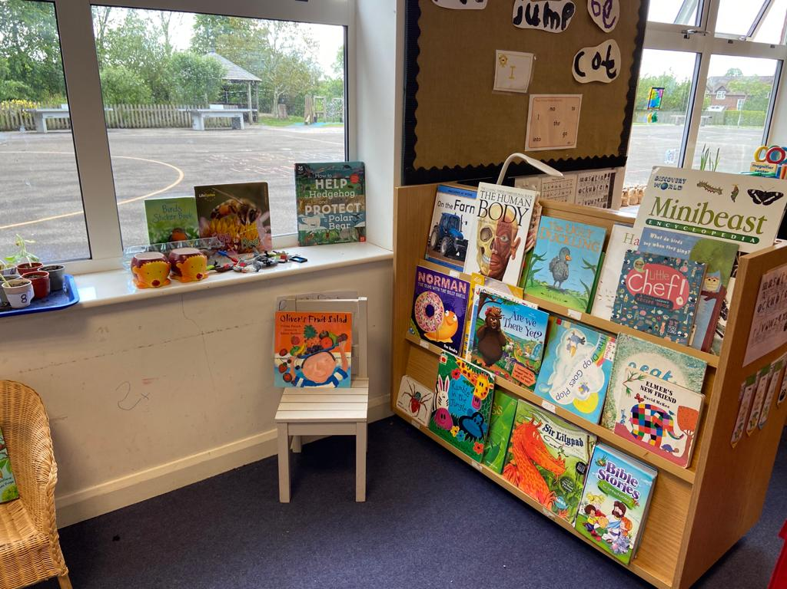
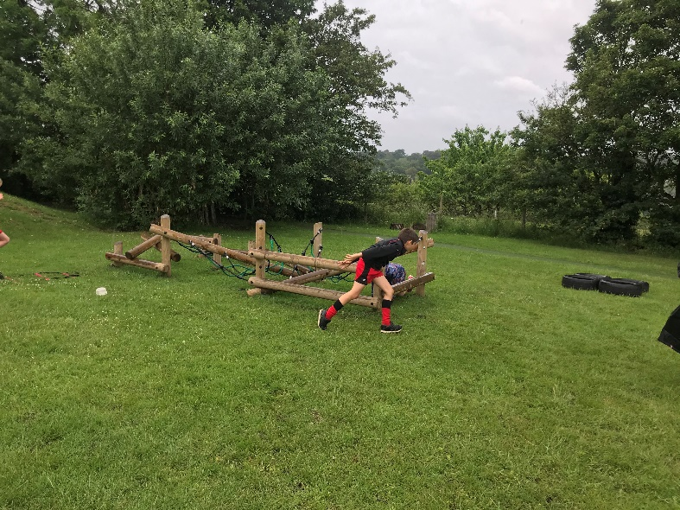
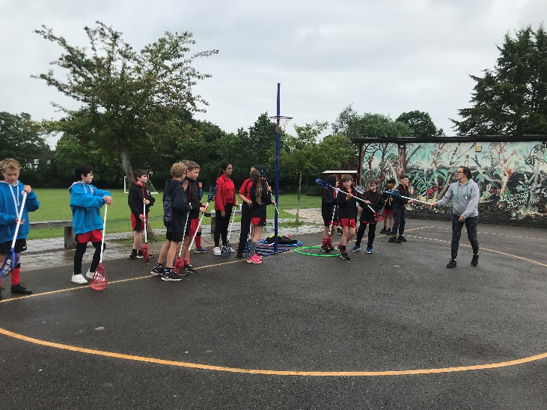
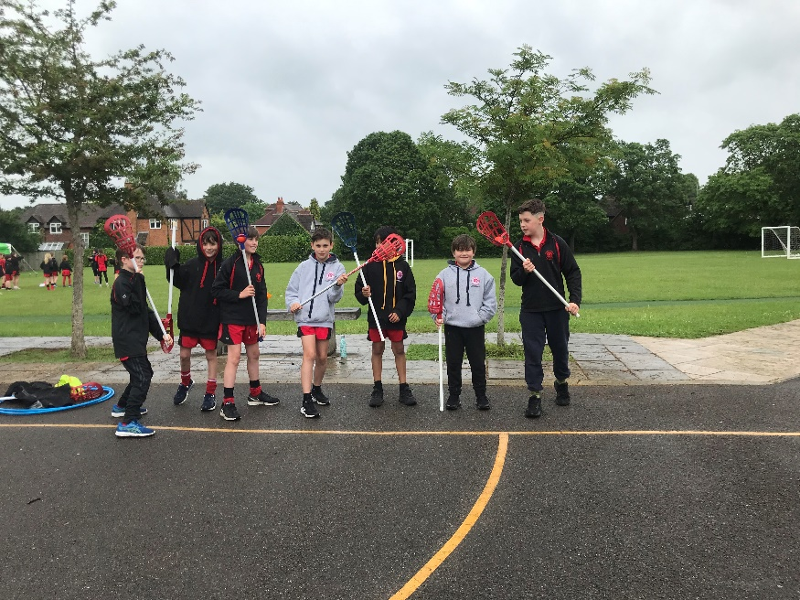
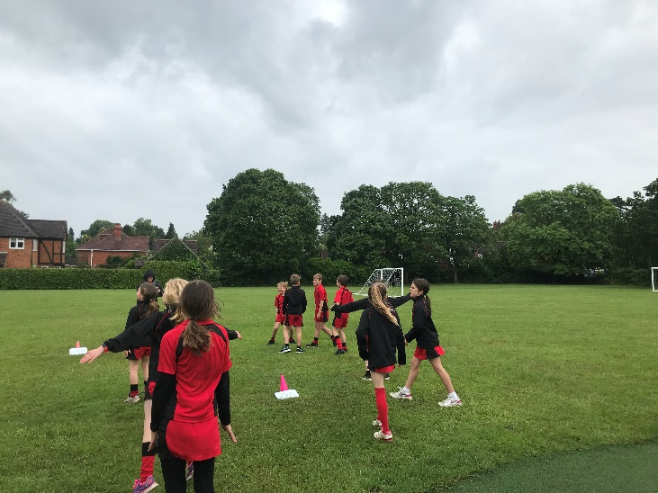
Where we all flourish

Slide 7
Assessment this year
Reception Baseline assessment
KS1 SATS – (last year of SATS in year 2) maths and reading– June
KS2 SATS – maths, spag, reading - May
Phonics screening for year 1 – June
Phonics test for current year 2 after half term because they missed out earlier this year.
Multiplications Tables Check for year 4 – June

Slide 8
Ofsted– What are we doing?
By further developing teaching and learning, pupils’ progress in mathematics continues to accelerate
  Consolidate and continue to develop our maths curriculum – we purchased Abacus Maths scheme,
  Maths intervention programme purchased to support those children who need extra time
  More opportunities for children to develop their reasoning skills. Children are expected to complete some examples of their learning but after 10 minutes of each maths lesson, they assess where they are and either consolidate their learning or move their learning on.
  Resources put in to support the children who are vulnerable to achieve ARE –Teachers have been trained in deepening children’s learning in maths either through greater depth activities or through the pink questions during marking and feed back to the children.
  Workshops planned for this year so that parents can support their children better.
  Catch up funding being used to support children in small group sessions

Slide 9
Ofsted – what are we doing?
every opportunity is taken to enhance pupils’ cultural capital and ensure that pupils are ready for of life in modern Britain.
  Enhance our ICT facilities – 2 class sets of ipads in school, every class with own set of laptops, interactive whiteboards installed in every classroom
  Ensure that children have an understanding of global issues – Picture News for the whole school
  Continue to develop links with the wider community – work with Rotary and Rotakids
  Continue to develop links with church – re-introduction family service 4@4, Pupils4Praise, role of chaplain in school
  Develop links with Iybas school in Sierra Leone –
  Focus on mental health – mind up programme, emotional wellbeing ambassadors, 1 more TA trained in ELSA, nurture group to be up and running before Christmas for KS1
  Reinstate leadership roles in school – school council, eco warriors, digital leaders, Pupils4Praise, Rotakids,
  Continue to promote positivity, resilience and self challenge through our work on growth mindset

Slide 10
SIAMS– What are we doing?
As part of the planned professional development in support of religious education (RE), leaders should ensure that the teaching of reflective work is as demanding as the challenge pupils enjoy in developing their understanding of religions and religious concepts.
More reflections were evident in books about what children feel as a result of what they had learned in their RE lessons – how this impacts on their own lives.
• Ensure the school’s Christian foundation and values are clearly reflected on the website and in relevant policies and documentation so that these match the school’s good practice and Christian focus.
Our values are clear on our website.
Our bible verse that is used in our assemblies is displayed on our website
All school policies refer to our Christian values
The dioscese has verified that our values are evident in our curriculum and our behaviour.
• Building on existing good practice, provide opportunities for pupils to evaluate and contribute to the planning of collective worship to further enhance Christian distinctiveness.
Pupils 4 Praise children have led our assemblies both at school and in church at our harvest festival
Reflective outdoor area is used at lunch time.

Slide 11
Curriculum update
Our curriculum aims to develop a love of learning, inquisitive minds and equips them with the skills and knowledge to become socially responsible local and global citizens.
Topic based learning for as many subjects as we can so that children can make connections
Reception curriculum is based on children’s interests – planning in the moment
Work on feedback and marking ensures that this always moves the learning on.
School priority –
  Writing opportunities for purpose and audience across the curriculum. Boys writing
  Reading across the curriculum (fiction and non-fiction) with focus on reading for pleasure
  Maths – focus on reasoning and explanation
  From 2021 Relationships Education is now compulsory for all ages – covers Being Me In My World, Celebrating Differences, Dreams and Goals, Healthy Me, Relationships, Changing Me
  Embed the new phonics scheme Little Wandle

Slide 12
Physical and Mental Wellbeing
Wellbeing Framework project with RBWM completed last year.
Mind up programme now embedded
Physical wellbeing continues to be a focus for school – sports ambassadors leading activities at lunchtime for all children
A variety of after school clubs (tennis, football, netball, dance, rugby, running club, yoga, kickboxing and new gym club)
Use of the running track as part of curriculum
Competitions and festivals (as part of our SLA with Schools Sports Partnership) – now starting up again. So far we have taken part in year 5/6 girls football, year 3/4 girls football, Invictus games, year 1/2 Commonwealth Games Legacy, year 4/5/6 running competition
Participation sheets to ensure that all children across the year take part
Professional coach to accompany children to competitions (where appropriate and possible)
High quality PE curriculum lessons – teachers training
Leadership opportunities for children – sports ambassadors and sports organising crew.
KS1 Active Stars Award received 2021
School games award – on hold for the last 18 months. Hope to hold on to gold this year.
3 Tas now trained in ELSA – emotional wellbeing ambassadors to be re-inserted this term
Plan to achieve Healthy Schools Status

Slide 13

Notes:
This is the Inclusion Charter, co-produced with parents and carers, schools, health, the local authority and Achieving for Children.
It will be displayed in public areas - the Town Hall, libraries, youth centres, children’s centres.
Demonstrates what services will enable young people to do and why.

Slide 14
Inclusion
Inclusion Quality Mark awarded in May 2021
This year going for Attachment Aware Schools Award
SENCO is currently on maternity leave – being covered by Mrs Reekie

Slide 15
VCF
VCF = voluntary contribution fund
Can be one off payment or monthly contribution
Used to support our school budget – helps finance one of our teachers.

Slide 16
Further plans for next year
ensure the curriculum is ambitious and engaging for all learners
ensure that all children respect themselves, each other and their environment
ensure that all children are prepared for life in Modern Britain
ensure that all leaders take responsibility for upholding our culture and ethos

Slide 17

Any questions?

