Slide 1

Year Ahead 2020-2021
2nd December

Slide 2
Governors – Chair of Governors Mrs Claire Philpott
Headteacher – Mrs Fenella Reekie
Deputy headteacher – Miss Carys Windle

Slide 3
Our school values
Our School is
a family of learning at the heart of the community.
It is built on our Christian Values of
friendship, community, joy, peace, trust, endurance and forgiveness that help us:-
· Care and share
· Create a safe, happy and friendly place
· Encourage curiosity and creativity
· Nurture children and staff for their journey through life
· Develop responsibility and respect
· Inspire the very best in all of us

Slide 4
Our Visions for the school
That all children are accepted, loved, affirmed and fulfil their academic potential
That all children develop skills and enthusiasm as life long learners
That all children develop emotional and spiritual resilience through living out our Christian values

Slide 5
What did we learn?
That it is difficult to help your children with their work when you were taught to do things in a different way (in maths especially).
My children won't pick up a book unless it's required reading for their lesson
The children need the school environment to maintain focus and take in what they are being taught.
That the children need to mix with their friends and peers for their mental wellbeing.
It has been helpful for me to see how maths and methods are being taught first hand
At the start it was really hard to know exactly what level to start at and how to breakdown the work
Not knowing if we were doing enough was hard
I now understand so much more about how my child learns and the things he finds difficult, not just content, but also things like concentration etc and rewards
That teachers are superheroes, and children are more adaptable and resilient than we give them credit for.
That it is very hard trying to play the role of teacher as well as of mum.
My child’s inability to concentrate and a lack of motivation
My child’s love of learning
That they cover a lot in school! And that they miss group discussion/team activities
That we rely and need our teachers for the inspiration not just the tasks! And just how important their physical presence is. The videos were a good substitute, but we missed the teachers

Slide 6
What would parents like to see different?
With technology playing an ever increasing part in children's lives, perhaps some additional teaching around limiting screen time, strategies for switching off from it and the importance of technology breaks.
Communication between parents and teachers more would be fantastic
continue staggered drops/pick ups, no gathering in school yard before or after.
hand-washing stations, more cleaning of the school.
Lots of the activities that the school have sent us for us to do at home, either the learning activities, or the wider activities such as the sports day challenges are really nice to take on as a family – it would be great to continue doing some of these.
I’d like the EYFS and KS1 children in particular to have more forest school and outdoor learning
Parents- Continue to give parents and insight into the current childs learning, this could continue to be on a pre recorded video for the parents maybe twice a term!?
I would love to know more abut the specifics of what they cover each week so that we could talk about it more at home - the home learning maps/ vague lesson plans would help me to know where he was at and how I could better support (thinking most about phonics and maths) – obviously without creating lots of extra work for the teachers!

Slide 7
What next?
Think about how we can incorporate more flexibility in terms of children’s learning and interests and also school timings. How can we give our families more family time within school day?
Think about what more can we do to encourage more engagement with parents – in terms of understanding what their children can do and how their children learn and how that fits into what they are learning
Think about the importance of socialisation of school
Think about how we can build on our use of technology
Think about expectations around outdoor learning in our curriculum

Slide 8
Ofsted– What are we doing?
by further developing teaching and learning, pupils’ progress in mathematics continues to accelerate
  Maths is an area that has been highlighted as a weakness through this pandemic mainly around times tables, maths vocabulary, reasoning.
  More opportunities for children to develop their reasoning skills. Children are expected to complete some examples of their learning but after 10 minutes of each maths lesson, they assess where they are and either consolidate their learning or move their learning on.
  Resources put in to support the children who are vulnerable to achieve ARE using Catch up funding and maths intervention purchased
  Teachers have been trained in extending children’s learning in maths
  Focus for this year will be on times tables – particularly bearing in mind that from 2021 children in year 4 will be formally assessed on times tables

Slide 9
Ofsted – what are we doing?
every opportunity is taken to enhance pupils’ cultural development and ensure that pupils are ready for of life in modern Britain.
  Enhance our ICT facilities – 2 class sets of ipads purchased, interactive whiteboards installed in every classroom, moving to dojo to inform parents
  Ensure that children have an understanding of global issues – chances to debate in class. Resources purchased to enable class debates on a weekly basis.
  Continue to develop links with the wider community – Rotakids worked really well within the community before March. Links with Elizabeth House and Harwood House prior to the pandemic
  Continue to develop work with church – introduce role of chaplaincy
  Continue to develop links with Iybas school in Sierra Leone –RE plan focuses on introducing children to a wide variety of religions and places of worship.
  Black History Month celebrated this year – with each class focussing on a historical figure in black history.

Slide 10
SIAMS– What are we doing?
As part of the planned professional development in support of religious education (RE), leaders should ensure that the teaching of reflective work is as demanding as the challenge pupils enjoy in developing their understanding of religions and religious concepts.
More reflections were evident in books about what children feel as a result of what they had learned in their RE lessons – how this impacts on their own lives.
• Ensure the school’s Christian foundation and values are clearly reflected on the website and in relevant policies and documentation so that these match the school’s good practice and Christian focus.
Our values are clear on our website.
Our bible verse that is used in our assemblies is displayed on our website
All school policies refer to our Christian values
The dioscese has verified that our values are evident in our curriculum and our behaviour.
• Building on existing good practice, provide opportunities for pupils to evaluate and contribute to the planning of collective worship to further enhance Christian distinctiveness.
Pupils 4 Praise children have led our assemblies
Pupils 4 Praise will be involved in the role of a chaplain at school

Slide 11
Curriculum update
Cornerstones will continue to drive our creative curriculum. Children have the chance to learn geography, history, science, music, art and writing through our topic work
Literacy – continue to provide many opportunities outside of the classroom for the children to write with a focus on spelling, punctuation and grammar with audience and purpose at the heart of writing. We are currently looking into a new spelling programme
Maths – Catch up funding, new intervention programme
PE - with government focus on child obesity, physical education is high on our agenda.
Running track complete – children will run for 10 minutes on the days when they don’t have PE lesson ; children taking part in Virtual School Games ; Dan the Skipping Man booked for Spring term. We have been awarded the Gold Sportsmark.
Science Week - Spring term
Computing –e-safety continues to be a focus ; parent information session planned for Spring term.
Music – some peripatetic teachers have returned this term with more planned to start after Christmas -. All children will learn percussion, recorders and ukelele within the curriculum before leaving Cookham Dean. Rocksteady and choir to start in Spring term (fingers crossed)
PSHE - Compulsory relationships and health education from Summer 2021. School follow Jigsaw scheme of work which follows the DfE guidance
Relationships Education Health Education
Families and people who care for me Mental wellbeing
Caring Friendships Internet safety and harms
Respectful Relationships Physical health and fitness
Online Relationships Healthy Eating Being safe Drugs, alcohol and tobacco Health and prevention
Basic first aid
Changing adolescent body
There will be a parent consultation in the Spring Term on PSHE

Slide 12
Mental Wellbeing
Mind Up programme – brain breaks, understanding how the brain works and how this impacts on relationships and behaviour
KS2 have had 2 workshops on resilience and being brave
ELSA will be starting after Christmas
SLT attended Wellbeing for Education Seminar rolled out by DfE with focus on resilience
Emotional Wellbeing Ambassadors to start up after Christmas
Nurture Group to start up in Spring Term.

Slide 13
Inclusion
RBWM Ofsted 2017 – SEND parents reported they found difficulty accessing services
School awarded inclusion mark last year
Inclusion summit featured video from Cookham Dean Emotional Wellbeing Ambassadors
Inclusion mark being rolled out across the whole borough

Slide 14
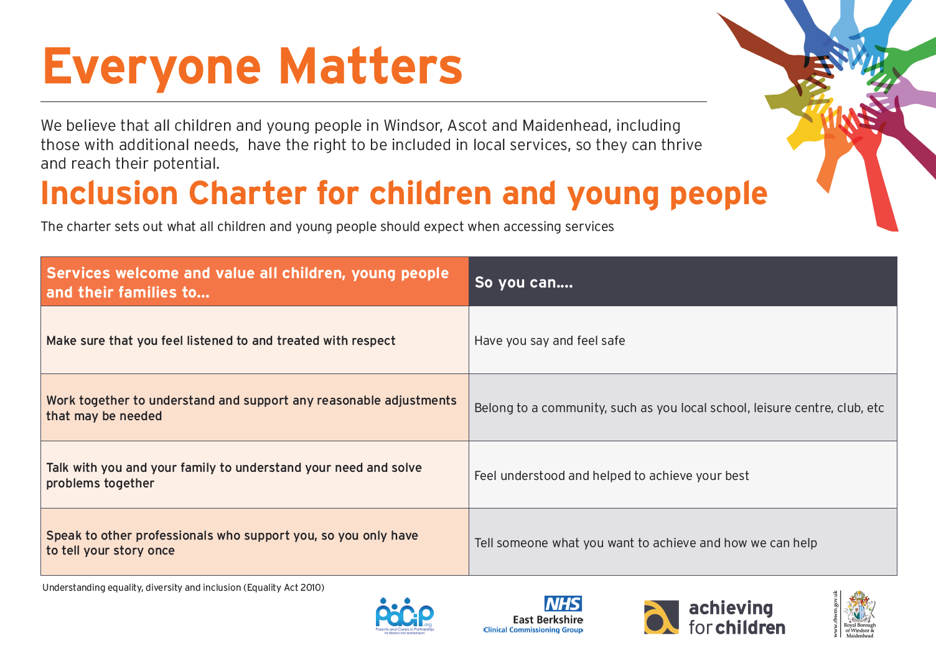
Notes:
This is the Inclusion Charter, co-produced with parents and carers, schools, health, the local authority and Achieving for Children.
It will be displayed in public areas - the Town Hall, libraries, youth centres, children’s centres.
Demonstrates what services will enable young people to do and why.

Slide 15
VCF
VCF = voluntary contribution fund
Used to support our school budget
School budgets are reducing – from September 2021 we will be moving to 28 in a class.
We do extra funding ie. Pupil premium, sport premium but this is ring fenced
We have been able to receive charity funding eg. library, interactive whiteboards to finance specific projects.

Slide 16
Plans for next year
Ensure that progress in maths continues to improve
Improve attainment in writing, particularly for boys
Continue to develop our children as good citizens
Continue to strive towards outstanding for Ofsted (Officially our next inspection would be March 2021 but this will be delayed.)
Maintain our focus on our Christian distinctiveness whilst being wholly inclusive.
Ensure that focus on mental wellbeing for all is maintained.

Slide 17

Any questions?

