Slide 1
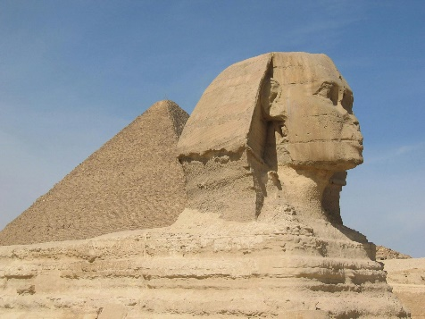
ENGLISH
Texts: Marcy and the Riddle of the Sphinx by Joe Todd-Stanton
The Story of Tutankhamun by Patricia Cleveland-Peck
SPaG:
Pronouns, conjunctions, present perfect, nouns, adverbs, prepositions, fronted adverbials, commas, possessive apostrophe, direct speech, capital letters, full stops, exclamation marks, question marks.
Guided reading
A variety of fiction and non-fiction texts, thinking about vocabulary, inference, predictions, explaining, retrieval and summarising
MATHS
Addition and subtraction: add 2-digit and 3-digit numbers; subtract a 2-digit number from a 3-digit number; complements to 100; estimate answers; inverse operations; make decisions.
Multiplication and Division: using arrays; multiples of 2,5 and 10; sharing and grouping; multiply and divide by 3, 3xtable; multiply and divide by 4, 4xtable; multiply and divide by 8 and the 8xtable.
History
What was important to Ancient Egyptians?
Visit to the Ashmolean Museum, Oxford
SCIENCE
Amazing Magnets
Art
Drawing: growing artists to finish
DT
Textiles: Egyptian collars
PSHE
Families and Relationships.
Year 3
Autumn 2 Overview
PE
Hockey and Dance with Jane Douglas
RE
What kind of world did Jesus want?
Christingle/Christmas
Computing
Creating media
Music
Ballads to finish; Christingle; Creating Compositions

