Slide 1
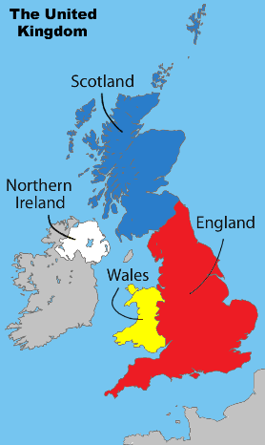
ENGLISH
Texts: Hello Lighthouse by Sophie Blackall
Writing genres: Informal letter; Narrative; Newspaper; Book review; Poetry; Diary entry. Extended narrative writing.
SPaG: nouns; pronouns; present perfect tense; past tense; conjunctions., adverbs, prepositions; fronted adverbials; commas; possessive apostrophes; inverted commas; understanding and using SPaG terminology.
Guided reading
A variety of fiction and non-fiction texts, thinking about vocabulary, inference, predictions, explaining, retrieval and summarising
MATHS
Multiplying by 10
Multiply a 2 digit number by 1 digit number (no exchange)
Multiply a 2 digit number by 1 digit number (with exchange)
Divide a 2-digit number by a 1-digit number - no exchange
Divide a 2-digit number by a 1-digit number - flexible partitioning
Divide a 2-digit number by a 1-digit number - with remainders
Reasoning about multiplication
SCIENCE
Light and Shadow
Geography
Are all settlements the same?
Year 3
Spring 1 Overview
DT
Textiles: Egyptian collars to finish
Mechanical systems: pneumatic toys
PSHE
Safety and the Changing Body
PE
Hockey
Gymnastics
RE
What is the Qur’an and why do many Muslims try to learn it by heart?
Computing
Programming: Sequencing Sounds
Music
Pentatonic melodies and composition

