Slide 1
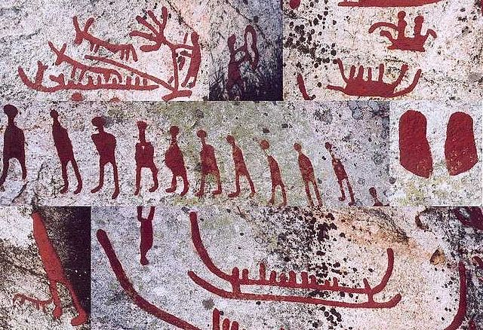
ENGLISH
Texts: Stone Age Boy by Satoshi Kitamura
Writing genres: Diary; Information; Narrative
Extended narrative writing
SPaG: nouns; pronouns; past tense; expanded noun phrases; conjunctions; adverbs; prepositions; fronted adverbials; commas; possessive apostrophes; inverted commas; varied sentence structure; understanding and using SPaG terminology.
Guided reading
Blue John by Berlie Doherty
MATH
Length and Perimeter: What is perimeter, measure perimeter and calculate perimeter.
Fractions: understand denominators and numerators, compare and order fractions, non-unit fractions, equivalent fractions, fractions on a number line and fractions as bar models.
Mass and Capacity: grams and kilograms, equivalent masses, millilitres and litres and compare capacity and volume.
RE
Why do Christians call the day Jesus died “Good Friday”?
SCIENCE
Roots and Shoots
PSHE
Citizenship (linked to Earth Day)
DT
Mechanical systems: pneumatic toys
Art
Painting and Mixed Media: prehistoric painting
Year 3
Spring 2 Overview
History
Would you have preferred to live in the Stone Age, Bronze Age or Iron Age?
Stone Age Extravaganza! Activity day
PE
Swimming
Dance
Music
Pentatonic melodies and composition to finish
Learning to play the recorder
Computing
Data Information – branching databases

