Slide 1
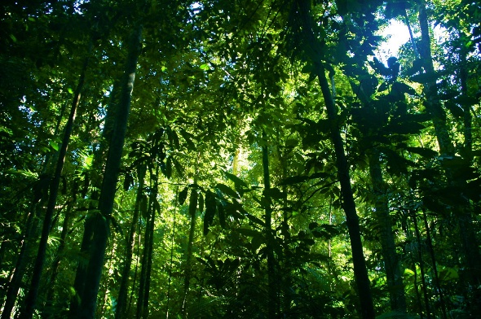
ENGLISH
Texts: Lights on Cotton Rock by David Litchfield
Writing genres: narrative; comic strip; newspaper; diary; poetry; non-chronological report.
Extended writing: narrative writing
SPaG: nouns; pronouns; various tenses; expanded noun phrases; conjunctions; adverbs; prepositions; fronted adverbials; commas; possessive apostrophes; inverted commas; varied sentence structure; paragraphs; understanding and using SPaG terminology.
Guided reading
Blue John by Berlie Doherty to finish
Luna and the Treasure of Tlaloc
MATHS
Fractions: understand denominators and numerators, compare and order fractions, non-unit fractions, equivalent fractions, fractions on a number line, fractions as bar models,
add and subtract fractions, unit and non unit fractions of a set of objects and reasoning with fractions of an amount.
Mass and Capacity: grams and kilograms, equivalent masses, millilitres and litres and compare capacity and volume.
RE
When Jesus left, what was the impact of Pentecost?
SCIENCE
Artful flowers, fruits and seeds
PSHE
Economic well-being
Year 3
Summer 1 Overview
Geography
Why are rainforests important to us?
Music
Learning to play the recorder
PE
Athletics
Gymnastics
Art
Painting and Mixed Media: prehistoric painting – to finish
Design and Technology
Cooking and nutrition: eating seasonally
Computing
Creating media – desktop publishing

