Slide 1
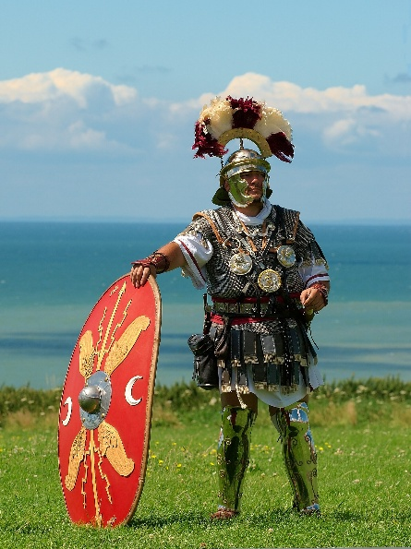
ENGLISH
Texts: The Boy Who Grew Dragons by Andy Shepherd; The Firework Makers Daughter by Phillip Pullman; Ride of Passage (film)
Writing genres: poetry; information text; interview; setting description; diary; letter; myth; recount; narrative
Extended writing: narrative writing
SPaG: nouns; pronouns; various tenses; expanded noun phrases; conjunctions; adverbs; prepositions; fronted adverbials; commas; possessive apostrophes; inverted commas; varied sentence structure; paragraphs; understanding and using SPaG terminology.
Reading
Luna and the Treasure of Tlaloc by Joe Todd-Stanton
MATHS
Time: Roman numerals to 12; tell the time to 5 minutes; tell the time to the minute; digital time; use a.m. and p.m.; years, months and days; days and hours; hours and minutes; minutes and seconds; solve time problems.
Shape: turns and angles; right angles; compare angles; measure and draw accurately; horizontal and vertical; parallel and perpendicular; recognise and describe 2d shapes; draw polygons; recognise and describe 3d shapes; make 3d shapes
Statistics: interpret pictograms; draw pictograms; interpret bar charts; draw bar charts; collect and represent data; two-way tables.
SCIENCE
Keeping Healthy
Music
Traditional instruments and improvisation: India
PSHE
Economic well-being to finish
Healthy and Well-being
Healthy Schools Week
Year 3
Summer 2 Overview
RE
Does it matter if a story is true or not?
History
Why did the Romans invade and settle in Britain?
Roman day at Ufton Court 22/6/26
Computing
Creating media – desktop publishing to finish
Programming
Design and Technology
Cooking and nutrition: eating seasonally
Art
Abstract sculpture: shape and space
PE
Athletics/Sports Day/Healthy Schools Week activities/Cricket
Yoga/Gymnastics
This Photo by Unknown Author is licensed under CC BY-SA

