Slide 1

Welcome to Year 3!

Slide 2
Adults in the class
Class teacher: Mrs Thompson (Mondays and Tuesdays)/ Mrs O’Brien (Wednesdays – Fridays)
Class TA: Mrs. Terry (Mornings and 2 afternoons a week)
Other adult:
Señora Pow (Spanish Wednesday mornings)

Slide 3
Expectations:
All completed a jigsaw piece on the transition day – targets for the year
Behaviour – in class and out (list written together)
Class promises – try our best to do these
Toilet – before school, break, lunch are the preferred times and after 2pm. If have a medical need please let us know as will be allowed to go.
Work – at their own level, quietly – choose challenge
6 Rs – weekly focus on the board
Reward system – house points for behaviour, table points – tidiness, readiness, collaboration. Dojos – for work

Slide 4
 | Monday | Tuesday | Wednesday | Thursday | Friday
8.35 | Morning work/corrections | Morning work/corrections | Morning work/corrections | Morning work/corrections | Morning work/corrections
8:45 | Register | Register | Register | Register | Register
9.05 | Collective worship | Collective worship | Collective worship class/choir | Collective worship | Celebration
9.20 - 10.30 | Maths | Maths | Spanish | Maths | Maths
10.30 - 10.45 | B | R | E | A | K
10.50 - 11.10 | Library | Guided Reading | Guided Reading | Guided Reading | Guided Reading
11.10 -12.10 | English | English | Spellings English | English | English/Extended writing
12.10 - 1.10 | L | U | N | C | H
1.10 - 2.10 | Register RE | Register Dance/Gym | Register Maths | Register History/Geography | Register Science
2.15 - 3.15 | Art Story | Music Story | Computing Story | PE - outdoor Story | PSHE Story
Year 3 2025 - 2026

Slide 5
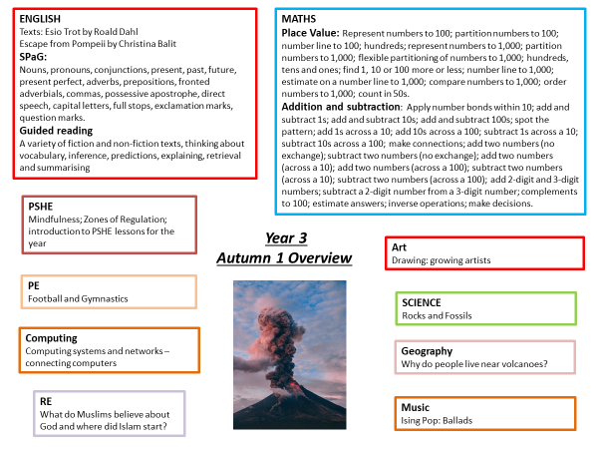

Slide 6
enrichment
Museum visit to support Ancient Egypt learning
Visits to Cookham Dean St John the Baptist church to support RE learning
Visiting the village to support geography topic
Visit to support Stone Age topic: outdoor museum
Egypt day in school – Autumn term 2 (dress up)
Roman day in school – Summer term 2 (dress up)
Literacy workshops online and in person
Living Rainforest trip
Sports events: plan for all children to attend at least one event

Slide 7
homework
Reading books will be changed regularly when they come in: please focus on your children's understanding
Spellings: test on Wednesdays
  Children will be introduced to the new spellings in school, and a list sent home each week. Please help your children to learn their spellings for the test
Times tables: TT rockstars
Maths and Literacy homework (alternate weeks) sent home on Tuesdays and back in for Mondays
Library book: our library day is Monday so please make sure that the book is in school ready to be changed

Slide 8
PE
Our PE days are Tuesday and Thursday, so please ensure your child comes into school in PE kit on these days.
As it starts to get colder, please make sure your child has adequate layers (black base layers, snoods, hats, gloves – but no scarves).
Swimming will be in the Spring Term – details to be shared as soon as they are available

Slide 9
Class Web Page
Information included:
Timetable
Termly topics
Curriculum overview – updated each half term
SPaG vocabulary
How to support your child reading
Spelling lists for the year
Maths methods
Maths vocabulary
Reading list ideas
Website ideas to support learning
Objectives for maths, reading and writing
Science vocabulary

Slide 10
communication
Message on Class Dojo: Urgent/last minute messages, or messages about children's learning
Email the office: Non-urgent
Class Reps for reminders
Catch us at the back gate at the end of the day

Slide 11
Any questions?

