Slide 1

Welcome to Year 2!
Where we all flourish

Slide 2
Year 2 staff
Mrs Hussain - Class teacher - Monday and Tuesday
Mrs Lodge - Class teacher - Wednesday, Thursday and Friday
Mrs Thrift – Teaching Assistant – Monday to Friday mornings

Slide 3
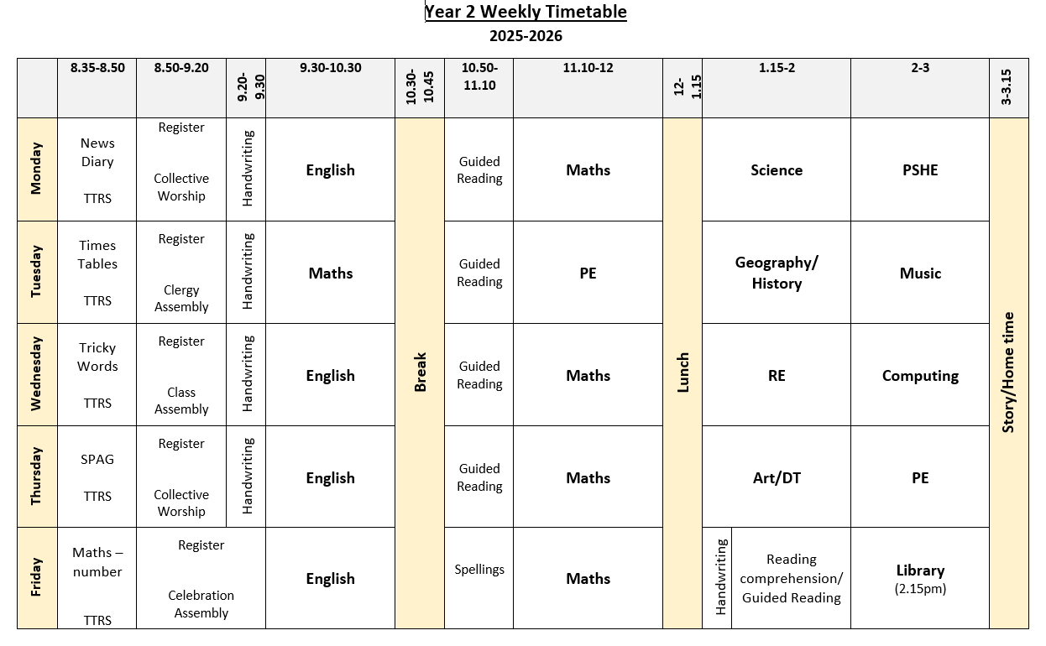

Slide 4
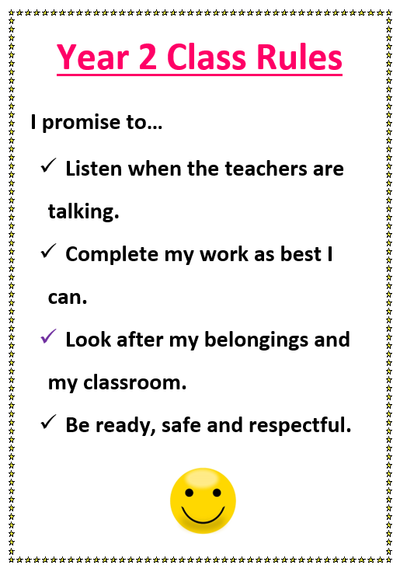

Slide 5
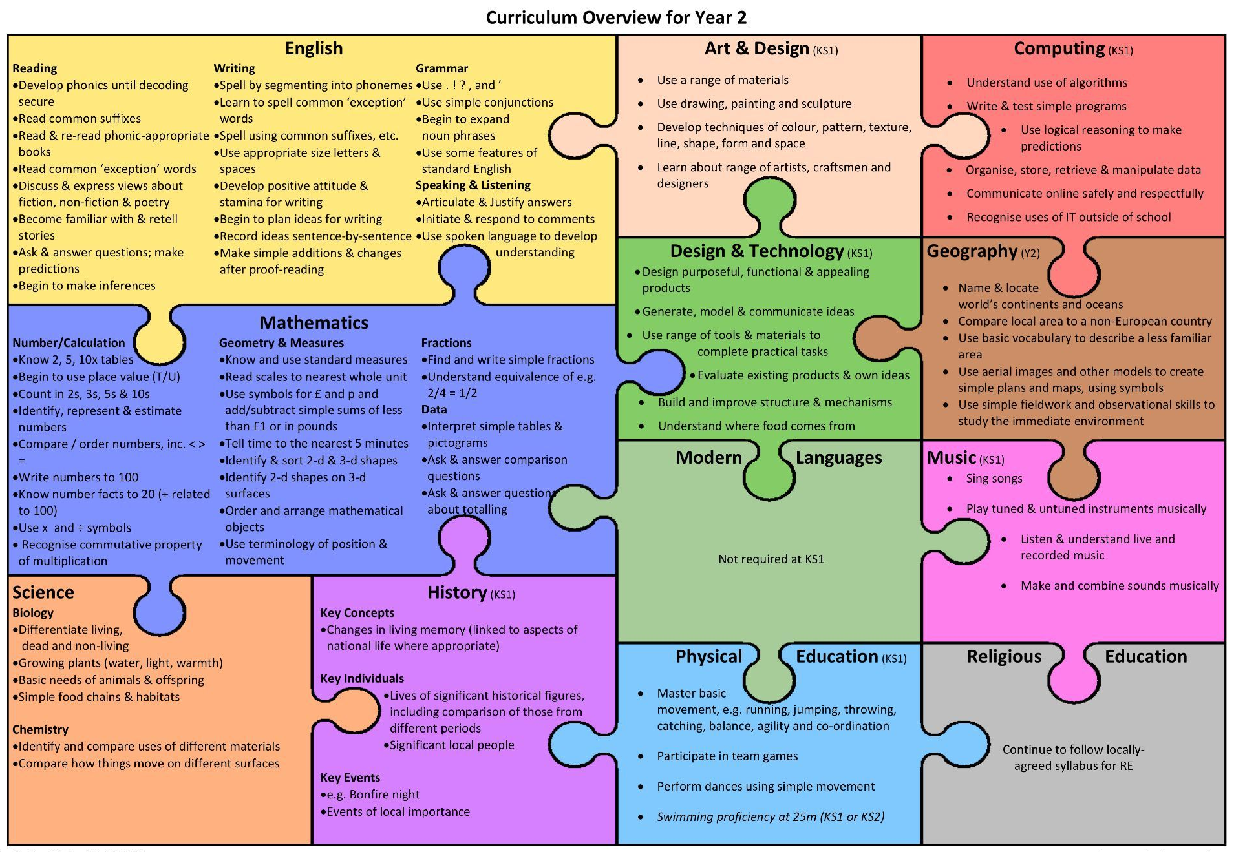

Slide 6
Term | Geography / History | Science
Autumn 1 | Why is our world wonderful? (G) | Healthy Animals
Autumn 2 | How was school different in the past? (H) | Gardens and Allotments
Spring 1 | What is a monarch? (H) | Habitats
Spring 2 | What is it like to live by the coast? (G) | Materials Matter
Summer 1 | How did we learn to fly? (H) | Squash, Bend, Twist, Stretch
Summer 2 | Would you prefer to live in a hot or cold place? (G) | Ready, Steady, Grow

Slide 7
Trips
Autumn - Reading Museum – Victorians
Spring - Windsor Castle – Monarchs
Summer - White Waltham Airfield – Flight
Half-termly curriculum overviews shared on class dojo/class website.

Slide 8
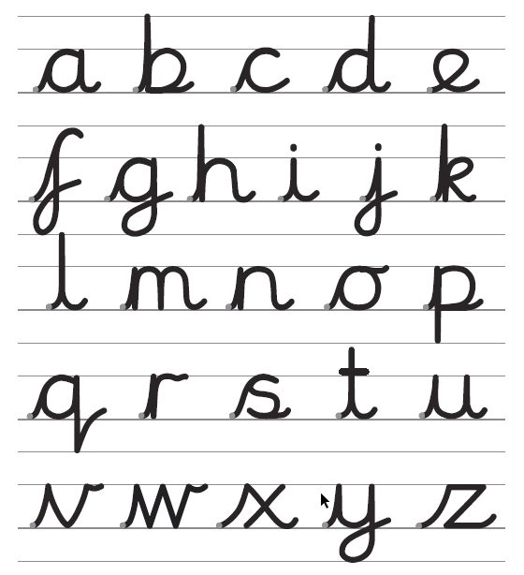
Handwriting
In handwriting lessons, we will teach children to write in the cursive style.
We hope all children will be joining up their letters correctly by the start of the summer term.
Parents can support their children by writing letters with lead-ins and lead-outs correctly on the line at home.

Slide 9
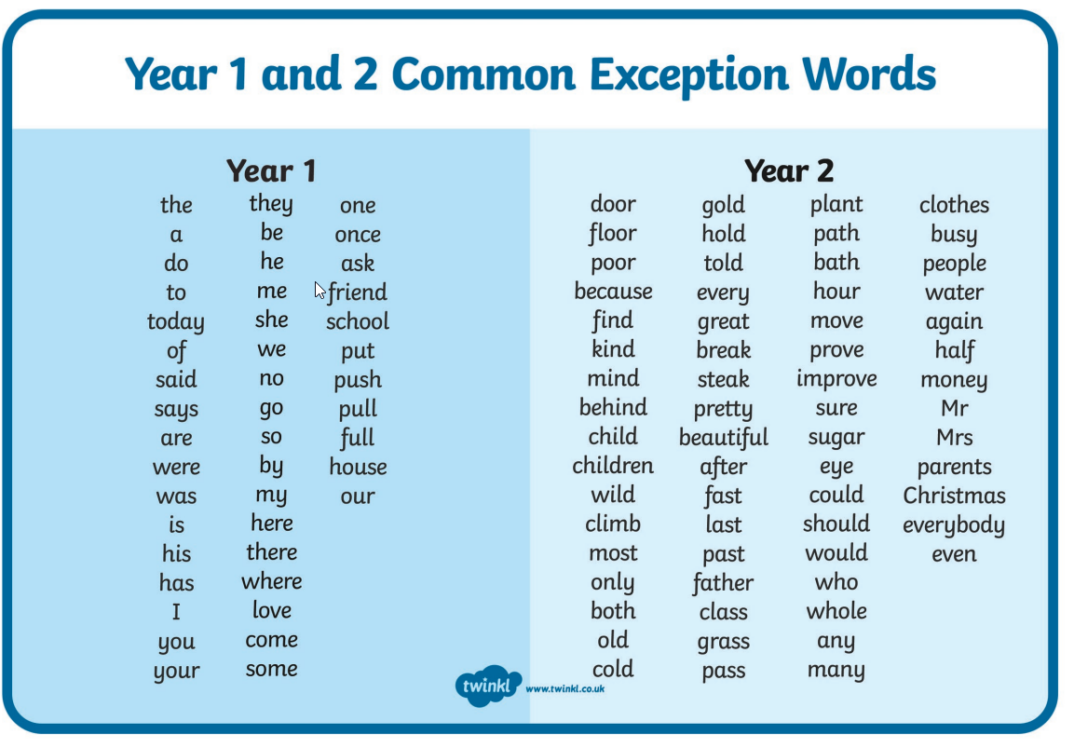

Slide 10
Homework
One piece of English/Maths homework
Set on Fridays and returned on Wednesdays.
Daily reading
Children to read at home daily and parents to sign reading record each time.
Books to be returned every Wednesday – new books sent home on Fridays.
School Library book
Children will choose a book from the Library. Must be brought into school every Friday to be changed.
Weekly spellings
These will be taught in school on Fridays and tested the following Friday.
Times Table Rock Stars
Focus on 2x, 5, 10x, 3x and 4x tables. Battles/Tournaments. Children to practise frequently at home/school.
Login/details to follow.

Slide 11
PE
PE days are Tuesday (indoors) and Thursday (outdoors).
Children can wear their PE kits to school on these days.
Please ensure all clothing is named.
Named water bottles brought into school every day.

Slide 12
Parental Involvement
Class Reps - Lisa Bishop (Tina) & Sylvia Rai (Jeevan)
Parent readers - must be DBS checked via school office. Usually takes place in the afternoon . Would prefer parents who can offer an hour each week on a set day.
Trips
Sporting events

Slide 13
Other information
PLEASE label all of your child’s items – ties, jumpers, water bottles, snack boxes, coats, gloves if you would like to receive them back!
PLEASE ensure your child arrives to school on time (8.35-8.45)
Every child to have a named water bottle. PLEASE ensure no water bottles are brought into school in book bags.
If your child is going home with another adult please send a note in with your child that morning/let staff know at the door.
Named welly boots are welcome and can be stored in school.
Fruit/vegetables available at break time but children are welcome to bring their own healthy snack from home.

Slide 14
Any appointments which take place during the school day – please notify the school office.
If your child is feeling upset in the mornings, please say ‘Goodbye’ and leave them with a member of staff to take care of.
Report cards and Parents meetings in November

Slide 15
Ways to communicate
Class Dojo – send a message to the relevant teacher/s.
Speak to a member of staff at the door in the morning to pass on a message.
Arrange an appointment with the class teacher if you have any concerns via class dojo or email the school office.
Also keep an eye out on our Class page on school website.

Slide 16

Any questions…

